Slide 1
EMO GROUP ANALYSES & RESULTS
Step By Step Review
Notes:
I know it’s been quite awhile since we all last got together to talk about the project. I think even then, there were some questions about the terms and methods, and I know that some have popped up over the past few months. So to make sure we’re all on the same page, I thought it’d be most efficient to toss everything into a quick powerpoint. Stop me at any point if you have any questions or want to focus on anything.

Slide 2
Participants
57 Total
21 Adults
Mean: 26.6 yrs old
SD: 5.08 yrs
Range: 20 – 44 yrs old)
36 Children
Mean: 7.03 yrs old
SD: 1.75 yrs
Range: 4 – 10 yrs old)
Notes:
We started off with 57 participants that are divided into two groups, 36 children and 21 adults. Age group was our primary predictor.

Slide 3
Stimuli
8 Movies:
Anastasia
Lion Kind
Little Mermaid
Rio
Open Season
Shark Boy and Lava Girl
Up
Wizard of Oz
Notes:
We had all participants watch clips from 8 different movies.

Slide 4
Stimuli
2 Clips From Each of the 8 Movies:
Pos Anastasia
Pos Lion Kind
Pos Little Mermaid
Pos Rio
Pos Open Season
Pos Shark Boy and Lava Girl
Pos Up
Pos Wizard of Oz
Neg Anastasia
Neg Lion Kind
Neg Little Mermaid
Neg Rio
Neg Open Season
Neg Shark Boy and Lava Girl
Neg Up
Neg Wizard of Oz
Notes:
Each movie provided one negative and one positively valenced clips. Clips were randomly ordered into three different conditions and participants were randomly assigned to a condition.

Slide 5
Brain Data
Each participant watched each video clip and their activation was recorded at 3 ROIs
AMY
NaCC
vmPFC
Brain activity was collapsed into copes, representing average activity within up to 339 voxels for each valenced video clip
Removed Voxels that did not register activity
i.e., produced 0’s for all copes
An average of ~220 voxels w/ usable data per cope.
Notes:
fMRI readings were recorded during passive viewing. For our project we focused on collection at 4 ROIs: ACC, AMY, NaCC, and vmPFC. After pre-processing, activity for each clip was averaged and collapsed into copes, consisting of up to 339 voxels. All copes had certain “dead areas” unique to each participant which registered no activity for across clips. These were removed prior to analysis so as to not artificially inflate correlative values.

Slide 6
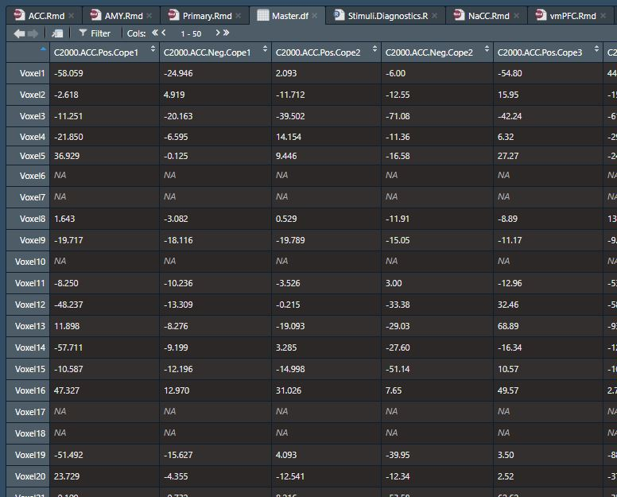
Example of Data Format
All Participants (57), ROIs (3), and Copes (16) [2736 Cols Total]
Voxels 1
Through
Voxel 339
Examples of removed voxels
Notes:
This is what our dataframe then looked like, with each column representing a unique participant, ROI, Valence, and Cope combo, and each row representing the 339 voxels. You can see here, the inactive voxels appear as NA, which our analyses will ignore.

Slide 7
Analysis
r_{Pos1Neg2} = 0.234
Within-ROI pairwise Pearson correlations for were performed between specific copes.
Voxels containing NAs were ignored.
Results were plotted into matrices
Notes:
We ran pairwise complete pearson correlations between specific cope pairs. Specifically, we skipped within movie comparisons. Correlations were our outcome variable and represent greater neural similarity between stimuli of similar or different valences. Because correlations require two components, we have to think about the valences of each of the clips used for each correlation, instead of the valence of a single clip. This would typically produce valence pairs of four categories, Pos Pos Neg Neg, Neg Pos and Pos Neg.

Slide 8
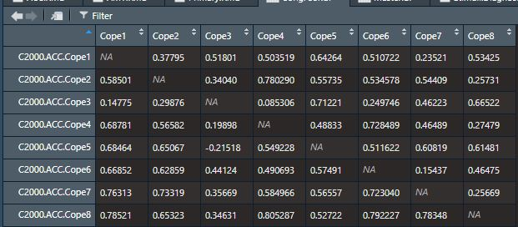
Correlation Matrix
Produced one 8 x 8 matrix each for Congruent and Non-Congruent Valence Pairs, for each participant (57), for each ROI (3), with 28 correlation values in each [19,152 correlations]
Because this was a transitory phase to get the data to long form, I didn’t mirror results along the diagonal as is tradition and instead put Pos – Pos above and Neg – Neg below, which also saved a little processing time.
Pos- Pos
Neg- Neg
Notes:
For congruent comparisons, we did not see many issues. They were plotted in an 8x8 correlation matrix. In order to avoid duplicated values which would clutter and increase processing time, |||
I scripted R to keep Pos Pos correlations above the ||| diagonal and Neg Neg comparisons below the diagonal. We initially did run Mixed valence comparisons, but I ultimately scrapped them from the analysis. I have a whole slide on the problems involved with them and why I clipped them that I plan to skip, but we could go over that if you guys want.

Slide 9
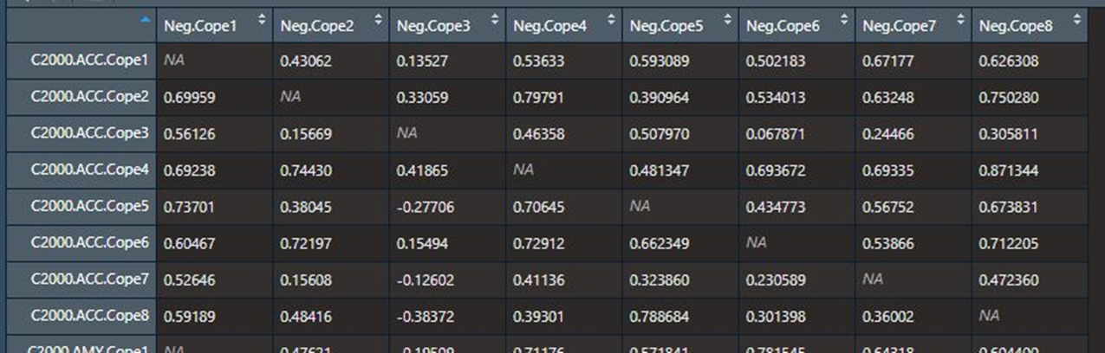
Correlation Matrix
I did the same thing for the mixed valence pairs, which originally presented a problem
Pos-Neg and Neg- Pos were collapsed into a “Mixed” category
They were eventually removed from analysis.
Pos- Neg
Neg- Pos
Notes:
Titles along the horizontal axis represent negative clips and values along the vertical axis represent their positive counterparts. So Cope1 refers to the same movie, just different clips from that movie. ||| The distinction between Pos-Neg and Neg-Pos was arbitrary. It entirely depended upon which valence category the first half of the correlation fell into. Organizing the data this way initially kept all of our sample sizes identical and I expected that there should be no differences between the two groups. However, in practice that was not the case. I came to realize that is was because values at the far ends of the matrix (Copes 1 and 2 and 7 and 8) are over represented and underrepresented in these two groups. ||| As you can see, Neg Cope 1 does not have any correlations in the Pos-Neg group and the inverse is true for its positive counterpart. Furthermore, Cope 1 is one half of 25% of the correlations in these groups, which is also disproportionate. After trying to rearrange the groups a number of ways to be less arbitrary and evenly represented, I accepted I either had to collapse the groups or remove them entirely. I settled on creating a Mixed Correlation group whose sample size was double that of the other groups. I kind of struggled in making sense of results from the mixed valence group, but figured maybe someone else could. Eventually, I thought to try running all of my analyses without the Mixed variable, and that eliminated the issue with random slopes, as well as cleared up some issues with our assumptions. Since I didn’t know how much value they had anyway, I chose to go this route. I do still have the output with Mixed valence included.

Slide 10
Hypotheses
Correlations are our dependent variable
Measure how similarly two stimuli are represented in regional activity.
High positive r values suggest greater similarity in neural representation
Low positive r values suggest greater dissimilarity in neural representation
No average values were in the negatives
We expect differences in activity within our ROIs to differ by Age Group
Specifically, Adults would show greater nuance in emotional processing than children, which would produce greater activation variability, and thus, lower r values.
These differences may be valence dependent (i.e., greater differentiation among negative stimuli than positive) and thus, we may expect a main effect of valence as well as an interaction between Age and Valence.
Notes:
So once again, correlations are our dependent variable and we expect these to be predicted by age group and for the effect to be moderated by valence pair.

Slide 11
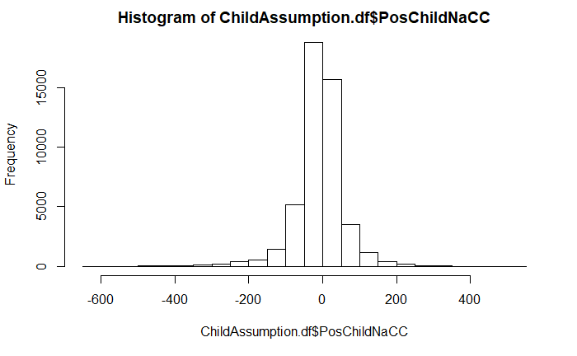
Assumptions and Violations
Activation data (before running correlations) was homoscedastic, reasonably normally distributed, with little skew, but had HIGH kurtosis.
Notes:
A few notes about the data. We did have crazy high kurtosis in the activation data prior to correlations being ran. Nothing we can reasonably do about that, I think, since I’m always reticent to transform the data.

Slide 12
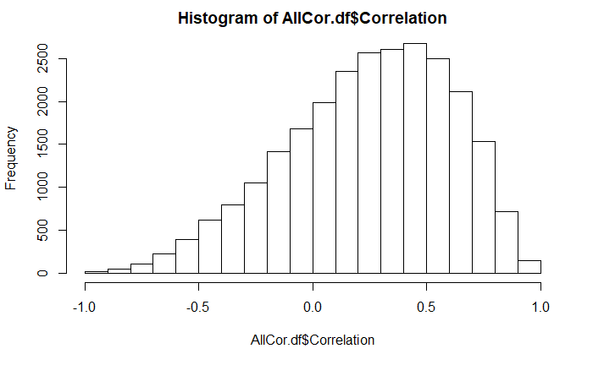
Assumptions and Violations
Correlation data was homoscedastic, no extreme outliers, and had reasonable kurtosis, but was negatively skewed.
Notes:
After correlations were ran, kurtosis was not an issue, but the data for all ROIs was negatively skewed. There were outliers identified, but none were deemed extreme enough to warrant exclusion using the mad median method.

Slide 13
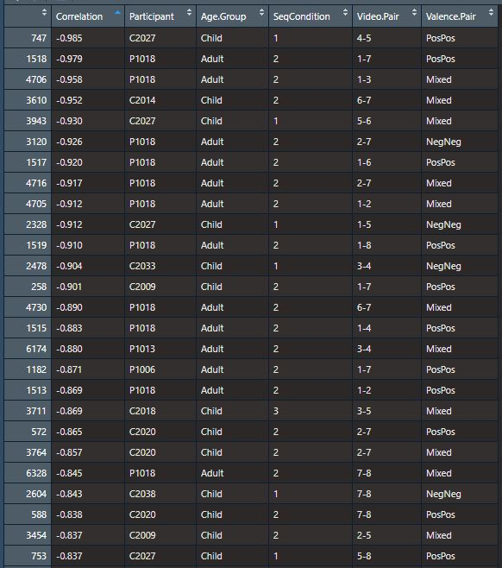
Dataframes
Data was transferred to ROI specific dataframes for the rest of analyses, so all analyses were performed three times (once per ROI)
Variables in models include:
Correlation
Participant
Age Group
Valence Pair
Variables that aren’t relevant but are present in figure are:
Condition
What order they saw the videos in; Originally thought this might have caused our Mixed Valence Problem
Video Pair
Movies ( e.g., “1-8” would be “Anastasia – Wizard of Oz”)
Considered this important to control for but may have caused overfitting in models.
Notes:
All of the data was reformatted to long form and separated by ROI.

Slide 14
Analysis
Mixed ANOVA Models
Our primary predictor or groups are categorical
Age Group constituted a Between Subject variable
Valence constituted a Within Subject Variable
Can adjust for lack of independence of measurement between groups (adjust for individual differences).

Slide 15
Amygdala
No main effect of valence [F (2, 110) = 1.52, p = 0.22, ω²_{p}= 0.006].
No main effect of age group [F (1, 55) = 0.42, p = 0.52, ω²_{p}= 0.018].
No interaction of age and valence category [F (2, 110) = 1.16, p = 0.32, ω²_{p}= 0.002].

Slide 16
Nucleus Accumbens
No main effect of valence [F (2, 110) = 0.88, p = 0.42, ω²_{p}= -0.001].
No main effect of age group [F (1, 55) = 1.18, p = 0.28, ω²_{p}= 0.039].
No interaction of age and valence category [F (2, 110) = 0.61, p = 0.55, ω²_{p}= -0.005].

Slide 17
Ventromedial Prefrontal Cortex
No main effect of valence [F (2, 110) = 1.14, p = 0.32, ω²_{p}= 0.002].
Main effect of age group present [F (1, 55) = 4.55, p = 0.037, ω²_{p}= 0.188].
No interaction of age and valence category [F (2, 110) = 1.71, p = 0.19, ω²_{p}= 0.008].

Slide 18
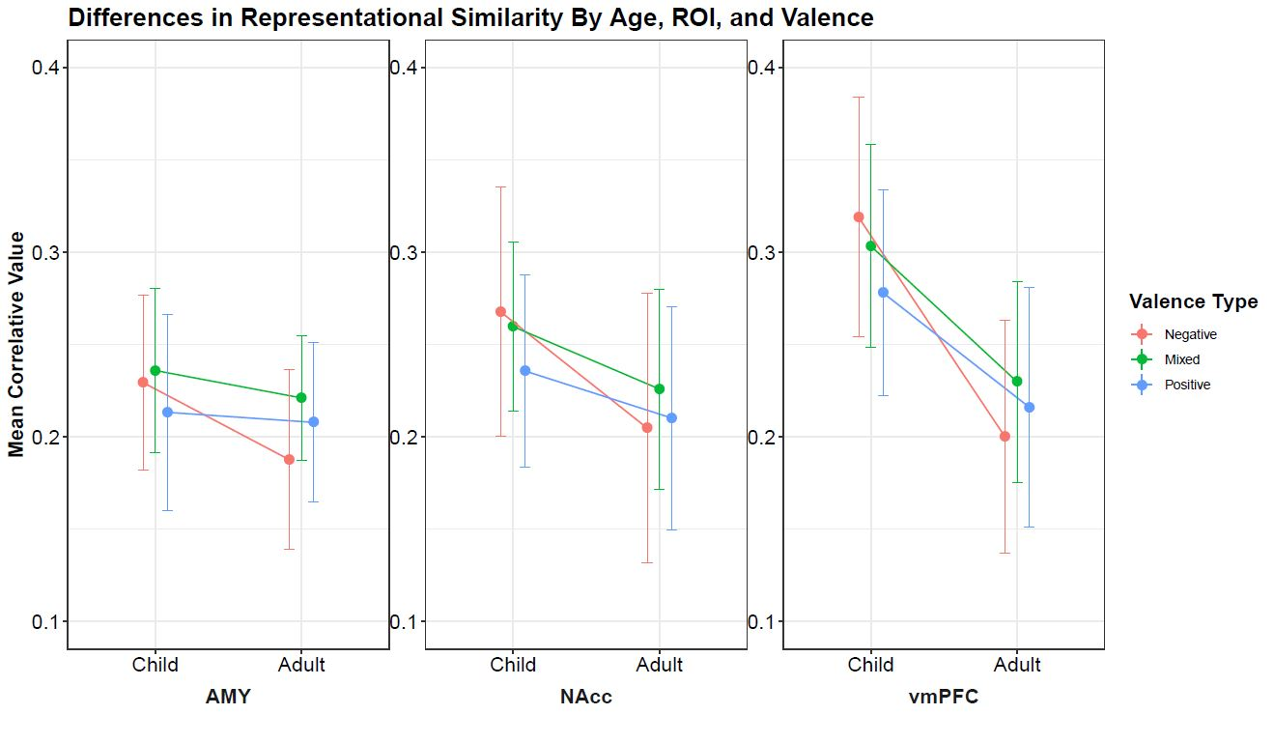
‘ = p < 0.01
* = p < 0.05
** = p < 0.01
*** = p < 0.001

Slide 19
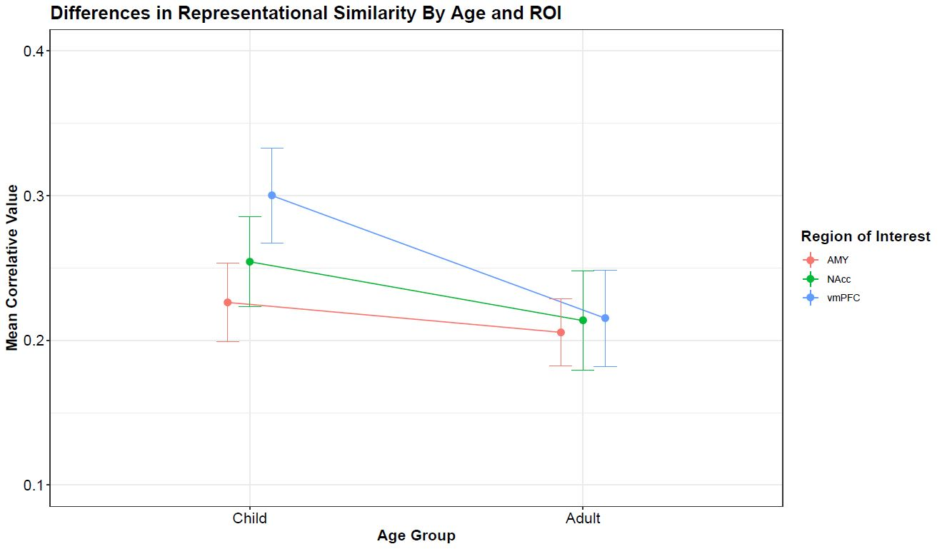
*
‘ = p < 0.01
* = p < 0.05
** = p < 0.01
*** = p < 0.001

Slide 20
Bivariate Fixed Effects Models
Age Group significantly predicted differences in neural activation similarity, such that, adults typically demonstrated lower correlation values than their younger counterparts.
Age Group Predicts Variance Differences in Activation
==========================================================================
Correlation (r value)
ACC AMY NaCC vmPFC
---------------------------------------------------------------------------------------------------
Age Group -0.046*** -0.024** -0.044*** -0.090***
(Adult) (0.015) (0.012) (0.013) (0.014)
Intercept 0.257*** 0.221*** 0.252*** 0.298***
(Child) (0.009) (0.007) (0.008) (0.008)
---------------------------------------------------------------------------------------------------
Observations 3,192 3,192 3,192 3,192
R2 0.003 0.001 0.003 0.014
Adjusted R2 0.003 0.001 0.003 0.013
Residual Std. Error (df = 3190) 0.396 0.318 0.364 0.369
F Statistic (df = 1; 3190) 9.82*** 4.08** 10.90*** 44.60***
=========================================================================
Note: *p<0.1; **p<0.05; ***p<0.01
Notes:
To start off, I wanted to establish that their was a relationship between age group and correlations. ||| Running a vanilla linear model, we see that across all ROIs, that seems to be true.

Slide 21
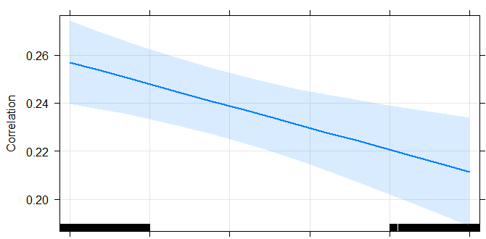
Neural Similarity By Age Group
Child
Adult
Notes:
Here’s an example from the ACC. Adults show lower correlation values than their younger counterparts, possibly suggesting greater variability in how these stimuli are represented.
At this stage, I would assume that the age group differences are a reflection of like a trajectory variance as we age. The more time passes, the more extraneous factors alter our path, the more our thinking reflects that. As we get more experience, we have more information to pull from when representing valence.
In itself, it’s not that interesting because there’s a lot of factors not accounted for, so…

Slide 22
Multivariate Fixed Main Effects Models
Age Group maintains significance as valence is included in the model. Valence does not predict activation at this stage.
Age Group and Valence Predict Variance Differences in Activation
======================================================================
Correlation (r value)
ACC AMY NaCC vmPFC
----------------------------------------------------------------------
Adult -0.046*** -0.024** -0.044*** -0.090***
(0.015) (0.012) (0.013) (0.014)
Positive Valence Comparisons -0.026* -0.003 -0.018 -0.020
(0.014) (0.011) (0.013) (0.013)
Intercept 0.270*** 0.223*** 0.261*** 0.308***
(0.011) (0.009) (0.010) (0.010)
----------------------------------------------------------------------
Observations 3,192 3,192 3,192 3,192
R2 0.004 0.001 0.004 0.014
Adjusted R2 0.004 0.001 0.003 0.014
Residual Std. Error (df = 3189) 0.396 0.318 0.364 0.369
F Statistic (df = 2; 3189) 6.61** 2.07** 6.45*** 23.50***
======================================================================
Note: *p<0.1; **p<0.05; ***p<0.01
Notes:
We added Valence Pair as well, which in itself, did not alter the effects of age group much, and didn’t offer any additional explanatory power.

Slide 23
Fixed Interaction Effect Models
Age Group maintains significance as interactions are added to the model. ROI specific valence main effects and interactions emerge.
Age Group and Valence Predict Variance Differences in Activation
=====================================================================================
Correlation (r value)
ACC AMY NaCC vmPFC
---------------------------------------------------------------------------
Adult -0.072*** -0.042** -0.063*** -0.119***
(0.021) (0.017) (0.019) (0.019)
Positive Valence Comparisons -0.045** -0.016 -0.032** -0.041**
(0.018) (0.014) (0.016) (0.016)
Adult / Positive Interaction 0.052* 0.036 0.037 0.057**
(0.029) (0.023) (0.027) (0.027)
Intercept 0.280*** 0.229*** 0.268*** 0.319***
(0.012) (0.010) (0.011) (0.012)
---------------------------------------------------------------------------
Observations 3,192 3,192 3,192 3,192
R2 0.005 0.002 0.005 0.016
Adjusted R2 0.004 0.001 0.004 0.015
Residual Std. Error (df = 3188) 0.395 0.318 0.364 0.369
F Statistic (df = 3; 3188) 5.50*** 2.19* 4.95*** 17.10***
=====================================================================================
Note: *p<0.1; **p<0.05; ***p<0.01
Notes:
When we move on to interactions, though, we see effects of age group increase a lot. Furthermore, we see notable differences in the ACC, NaCC, and vmPFC between Positive and Negative correlations.

Slide 24
Fixed Interaction Effect Models
Age Group maintains significance as interactions are added to the model. ROI specific valence main effects and interactions emerge.
Age Group and Valence Predict Variance Differences in Activation
=====================================================================================
Correlation (r value)
ACC AMY NaCC vmPFC
---------------------------------------------------------------------------
Adult -0.072*** -0.042** -0.063*** -0.119***
(0.021) (0.017) (0.019) (0.019)
Positive Valence Comparisons -0.045** -0.016 -0.032** -0.041**
(0.018) (0.014) (0.016) (0.016)
Adult / Positive Interaction 0.052* 0.036 0.037 0.057**
(0.029) (0.023) (0.027) (0.027)
Intercept 0.280*** 0.229*** 0.268*** 0.319***
(0.012) (0.010) (0.011) (0.012)
---------------------------------------------------------------------------
Observations 3,192 3,192 3,192 3,192
R2 0.005 0.002 0.005 0.016
Adjusted R2 0.004 0.001 0.004 0.015
Residual Std. Error (df = 3188) 0.395 0.318 0.364 0.369
F Statistic (df = 3; 3188) 5.50*** 2.19* 4.95*** 17.10***
=====================================================================================
Note: *p<0.1; **p<0.05; ***p<0.01
Notes:
Additionally, these models are improvements over the two previous models, judging by adj R squared values. Granted, these models are still very weak overall.

Slide 25
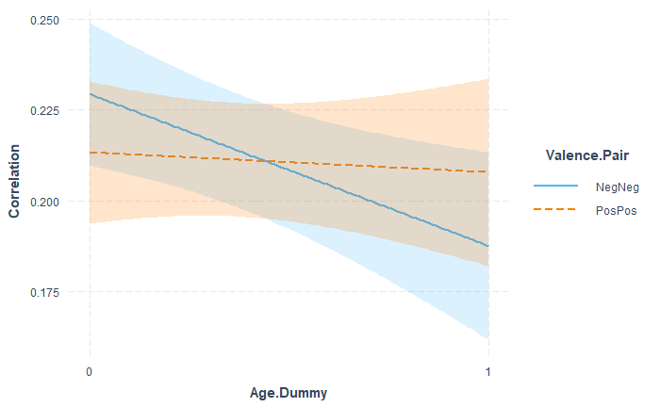
AMY
Notes:
Here we can see the interactions between the valences by ROI. 0 represents child and 1 represents adult as a reminder. We see pretty much across the board NegNeg showing what appears to be a notably different slope than pospos, which is notable when we move on to MLMs. The Amygdala appears to be the odd one out of the bunch.

Slide 26
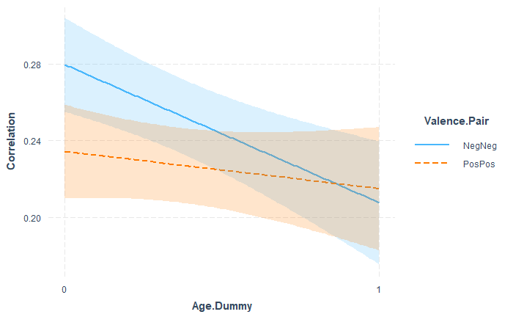
ACC
Notes:
The graphs for ACC, NaCC, and vmPFC looks pretty similar with NegNeg showing the greatest changes by age group.

Slide 27
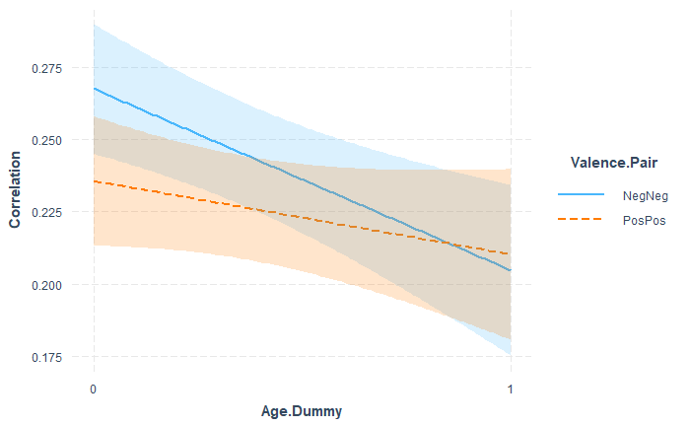
NaCC

Slide 28
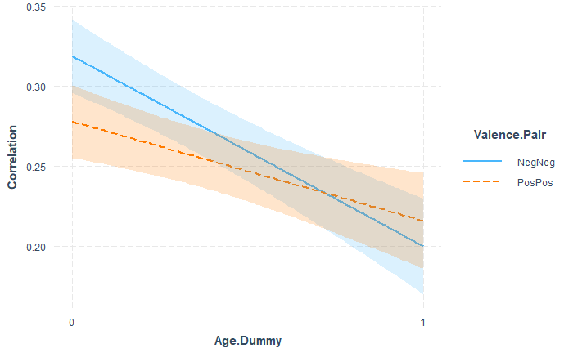
vmPFC
Notes:
Here for the vmPFC, you can see a similar pattern, although, if you pay attention to the confidence intervals, ||| you can se the significant interaction between Pos and Neg comparisons.
At this stage, given our adult population is more accurately described as “young adult”, I wonder if this is a reflection of the pre-positivity bias stages. My assumption is that when something looms larger in your awareness, there exists greater variability in how you analyze it. If young adults are prone to place greater focus on the negative than the positive, it might explain this flip. That in conjunction with a lack of sophistication or nuance in how children think of emotion might explain the flip.

Slide 29
Fixed Interaction Effect Models
Age Group maintains significance as interactions are added to the model. ROI specific valence main effects and interactions emerge.
Age Group and Valence Predict Variance Differences in Activation
=====================================================================================
Correlation (r value)
ACC AMY NaCC vmPFC
---------------------------------------------------------------------------
Adult -0.072*** -0.042** -0.063*** -0.119***
(0.021) (0.017) (0.019) (0.019)
Positive Valence Comparisons -0.045** -0.016 -0.032** -0.041**
(0.018) (0.014) (0.016) (0.016)
Adult / Positive Interaction 0.052* 0.036 0.037 0.057**
(0.029) (0.023) (0.027) (0.027)
Intercept 0.280*** 0.229*** 0.268*** 0.319***
(0.012) (0.010) (0.011) (0.012)
---------------------------------------------------------------------------
Observations 3,192 3,192 3,192 3,192
R2 0.005 0.002 0.005 0.016
Adjusted R2 0.004 0.001 0.004 0.015
Residual Std. Error (df = 3188) 0.395 0.318 0.364 0.369
F Statistic (df = 3; 3188) 5.50*** 2.19* 4.95*** 17.10***
=====================================================================================
Note: *p<0.1; **p<0.05; ***p<0.01
Notes:
Unfortunately, the ACC, AMY, and NaCC fail to show significant interactions, making a moderation test a bad move in those cases. When I tested moderation for the vmPFC using a simple slopes analysis, thought:

Slide 30
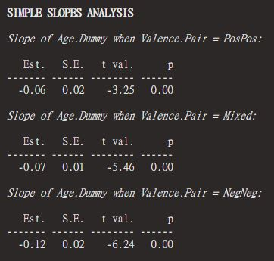
Valence as Moderator
A simple slopes analysis suggests that valence pair acts as a moderating factor for age group and activation similarity within the vmPFC
Notes:
The results further supported the idea that valence moderates the relationship between age group and valence similarity.

Slide 31
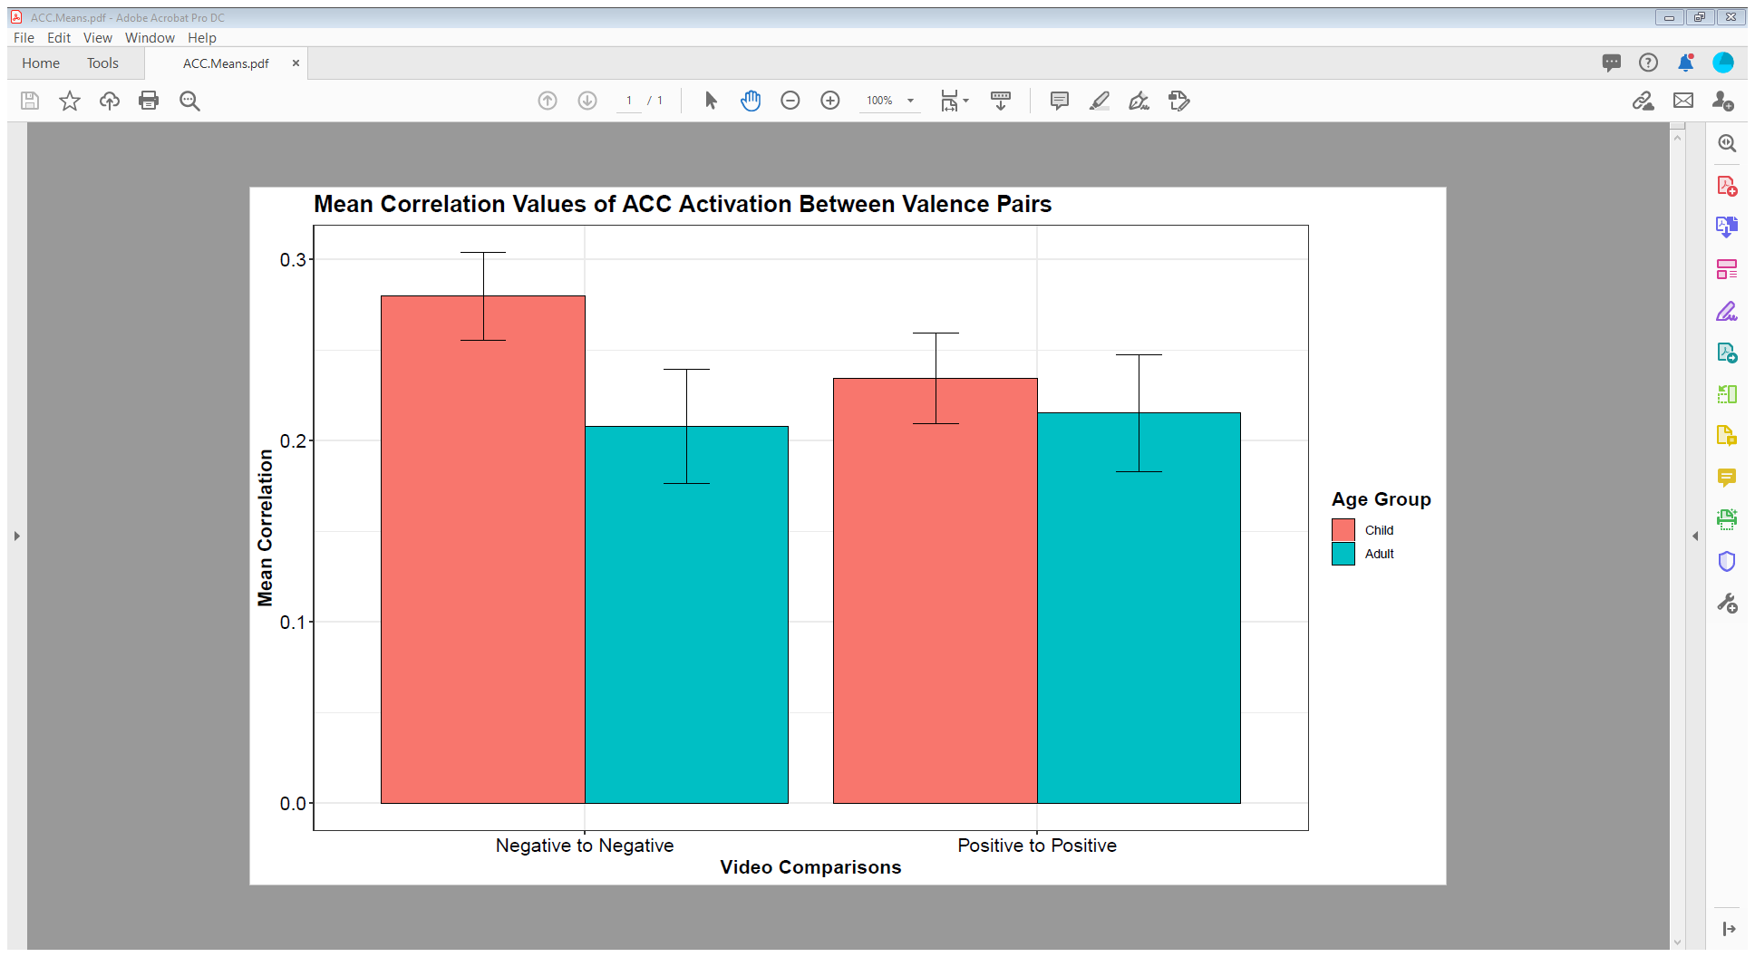
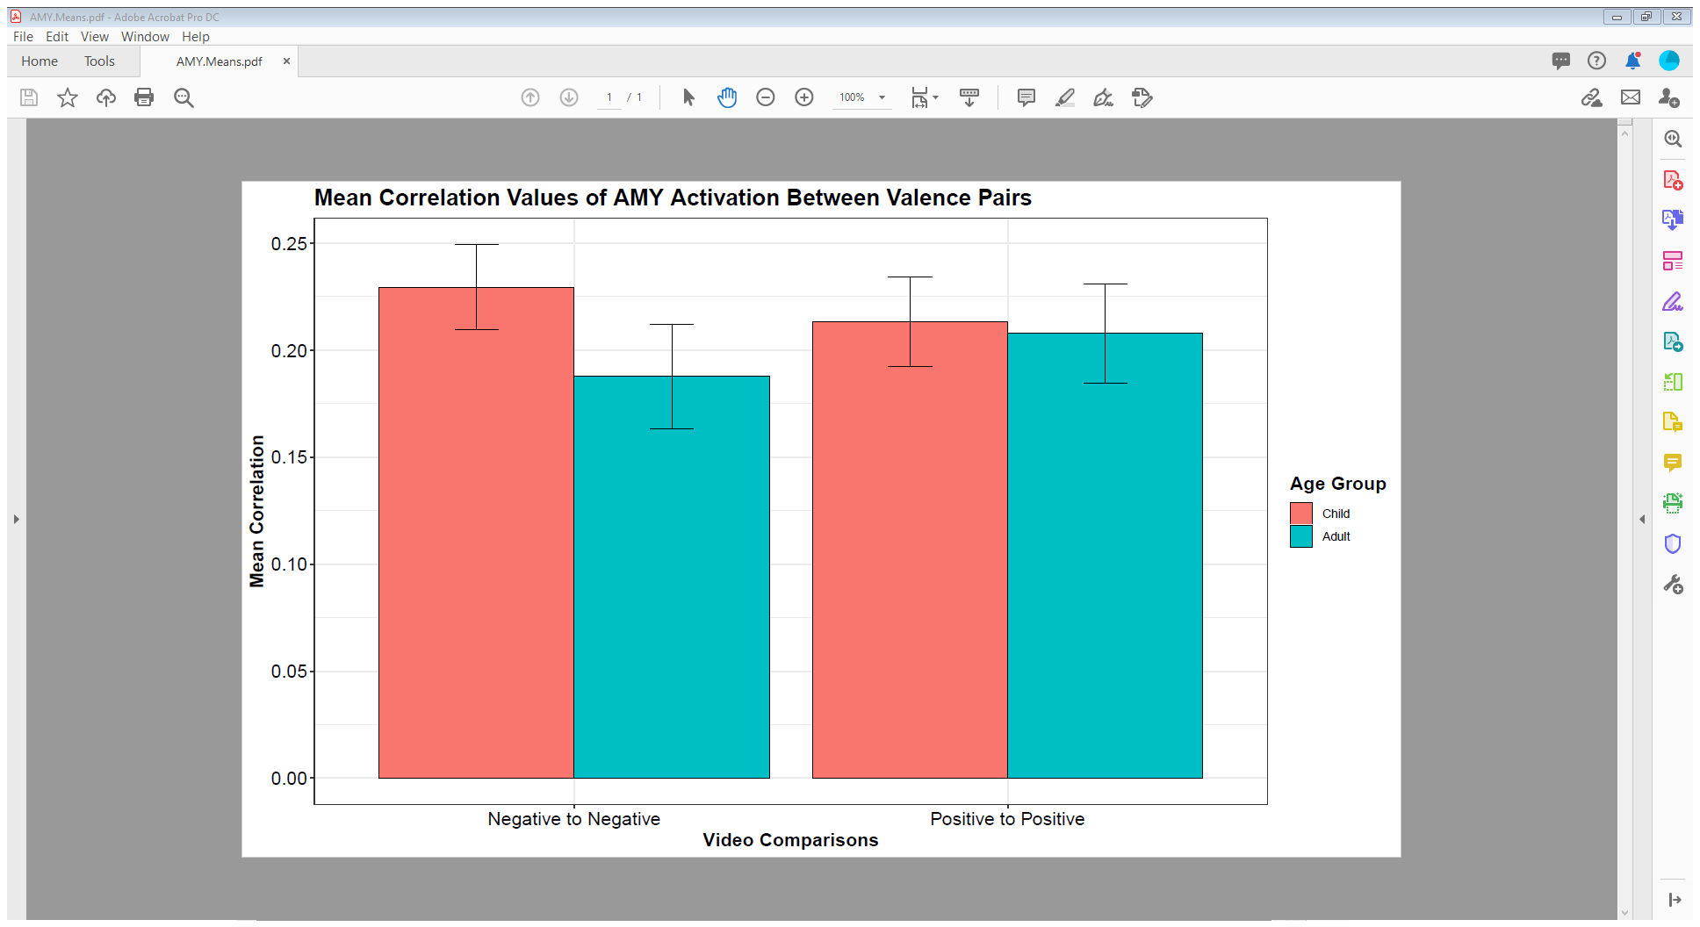
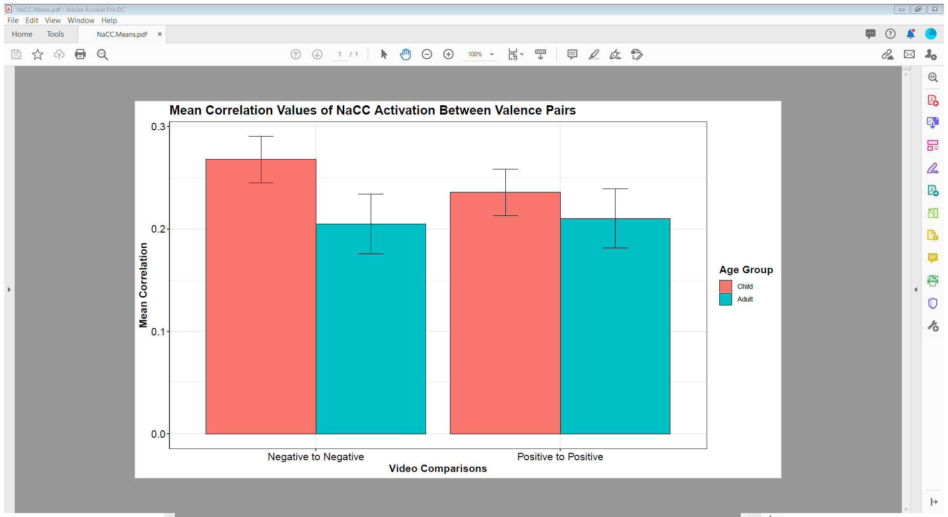
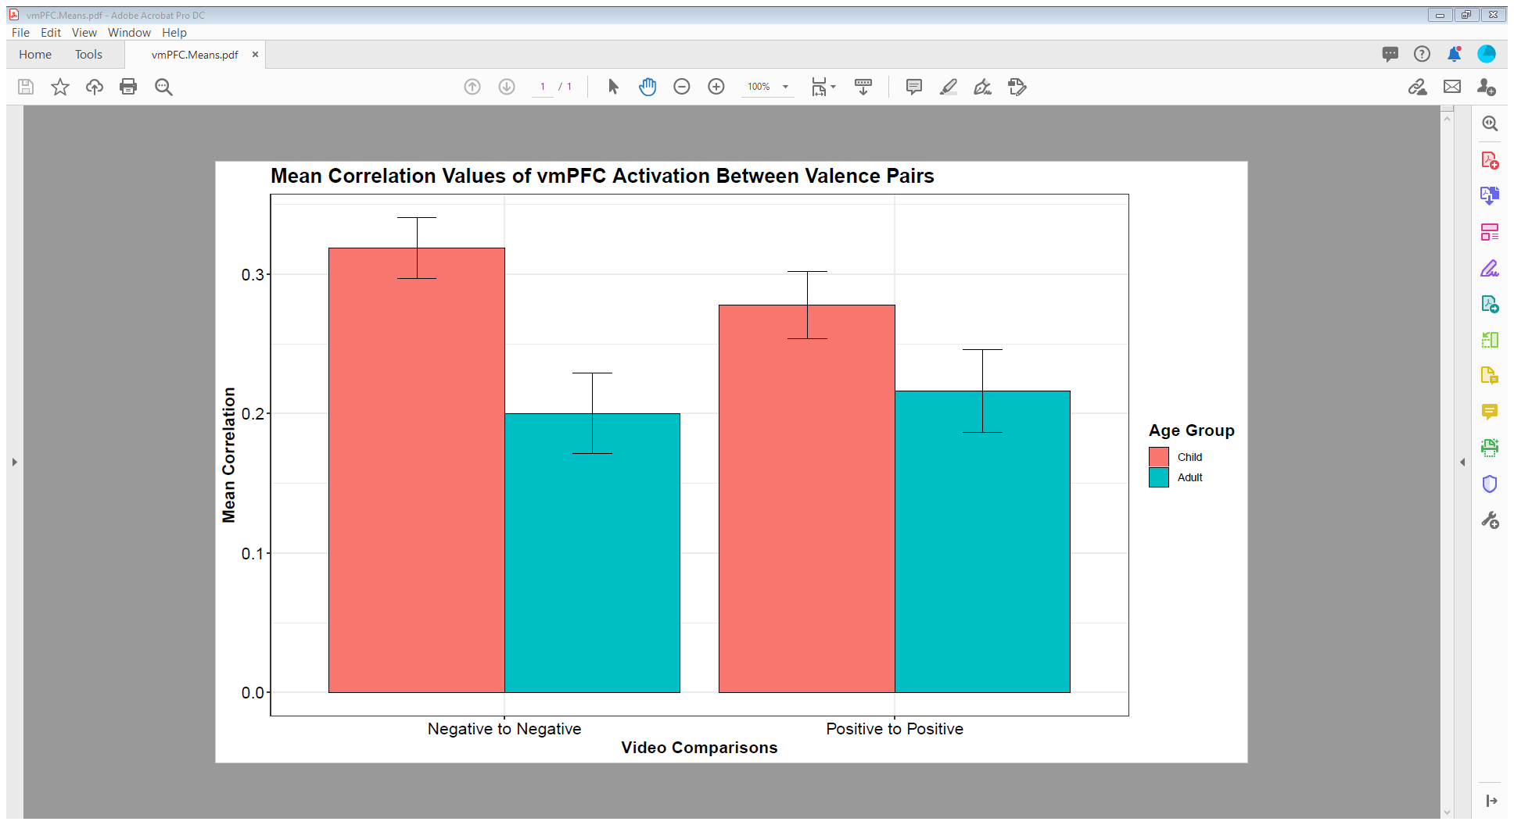
Notes:
These are just some nice little bar graphs illustrating the effects of age and valence . Again you can see in the ACC, AMY and NaCC some pretty mixed results, while the vmPFC shows a much cleaner story.

Slide 32
Age groups seemingly show differences… but will they survive adjustments for individual differences?
Notes:
So Age groups show differences, but will they stand up when we account for individual differences.

Slide 33
Mostly, No.
Notes:
So I broke the MLMs sort of into three stages. The first stage was just looking as Age as a fixed effect and Participant as a random effect. Then, because I expected that not everyone would emotionally categorize those clips the same, I would bring in valence as a random slope by participant. Finally, I would build a model accounting for the interaction between age and valence.

Slide 34
Data Issues
Uneven sample sizes in Age Group (Children to Adults)
Kurtosis in Activation Data
Negative Skew in Correlation Data
MLMs may have been significantly underpowered to measure effects, based on post-hoc analyses
(1000 Simulations) | Age Group | Valence
ACC | 20.50 % | 27.60 %
CIs | (18.04 % – 23.14 %) | (24.85 % – 30.48 %)
AMY | - | -
CIs | - | -
NaCC | 19.10 % | 15.30 %
CIs | (16.71 % – 21.68 %) | (13.12 % – 17.68 %)
vmPFC | 56.60 % | 26.40 %
CIs | (53.46 % – 59.70 %) | (23.69 % – 29.25 %)
Notes:
On top of that issue, we do have the minor issues of sample sizes, the kurtosis and negative skew, and, what I hadn’t mentioned earlier: power. I ran a post-hoc power analysis and found that, assuming our effect sizes are true, we may be underpowered to measure them. Even in the best case scenario, the vmPFC, we’re well shy of the typical 80% to measure both age effects and valence effects.

Slide 35
MLMs Adj. for Individual Differences
For ACC, AMY, and NaCC, Age Group’s influence was diminished once individual differences were included as a random effect in the model.
vmPFC maintained Age Group differences after allowing intercepts to vary randomly by participant.
ANTERIOR CINGULATE CORTEX
coef.est coef.se
(Intercept) 0.26 0.02
Age.Dummy -0.05 0.04
Error terms:
Groups Name Std.Dev.
Participant (Intercept) 0.13
Residual 0.37
---
number of obs: 3192, groups: Participant, 57
AIC = 2885.5, DIC = 2878
deviance = 2877.5
AMYGDALA
coef.est coef.se
(Intercept) 0.22 0.02
Age.Dummy -0.02 0.03
Error terms:
Groups Name Std.Dev.
Participant (Intercept) 0.11
Residual 0.30
---
number of obs: 3192, groups: Participant, 57
AIC = 1469.7, DIC = 1462
deviance = 1461.7
NUCLEUS ACCUMBENS
coef.est coef.se
(Intercept) 0.25 0.02
Age.Dummy -0.04 0.04
Error terms:
Groups Name Std.Dev.
Participant (Intercept) 0.13
Residual 0.34
---
number of obs: 3192, groups: Participant, 57
AIC = 2284.8, DIC = 2277
deviance = 2276.8
VENTROMEDIAL PREFRONTAL CORTEX
coef.est coef.se
(Intercept) 0.30 0.02
Age.Dummy -0.09 0.04
Error terms:
Groups Name Std.Dev.
Participant (Intercept) 0.14
Residual 0.34
---
number of obs: 3192, groups: Participant, 57
AIC = 2363.9, DIC = 2356
deviance = 2355.9
Notes:
The moment I added individual differences to the models, though, the ACC, AMY and NaCC packed their bags and went home. It pretty much sucked up all the variance we previously saw. ||| If we eyeball the estimates and standard errors for the top three models, we can see how close the estimates for adults and kids are. As a reminder kids are our reference group. That being said, the vmPFC made it through the first trial by the skin of its teeth with a 0.04 significance rating. We can also see that the average r value for kids was a .3 while adults dropped down to a .22.

Slide 36
MLMs Allowing Random Slopes
In all cases, adding valence pair as a random slope within participant resulted in better fitting models than null iterations.
However, valence was not a significant factor in any of these models.
ANTERIOR CINGULATE CORTEX
coef.est coef.se
(Intercept) 0.25 0.02
Val.PairPosPos -0.03 0.02
Error terms:
Groups Name Std.Dev. Corr
Participant (Intercept) 0.16
Val.PairPosPos 0.14 -0.55
Residual 0.37
---
number of obs: 3192, groups: Participant, 57
AIC = 2831.2, DIC = 2819
deviance = 2819.2
AMYGDALA
coef.est coef.se
(Intercept) 0.21 0.02
Val.PairPosPos 0.00 0.02
Error terms:
Groups Name Std.Dev. Corr
Participant (Intercept) 0.12
Val.PairPosPos 0.09 -0.29
Residual 0.30
---
number of obs: 3192, groups: Participant, 57
AIC = 1449.6, DIC = 1438
deviance = 1437.6
NUCLEUS ACCUMBENS
coef.est coef.se
(Intercept) 0.24 0.02
Val.PairPosPos -0.02 0.02
Error terms:
Groups Name Std.Dev. Corr
Participant (Intercept) 0.17
Val.PairPosPos 0.15 -0.68
Residual 0.33
---
number of obs: 3192, groups: Participant, 57
AIC = 2207, DIC = 2195
deviance = 2195.0
VENTROMEDIAL PREFRONTAL CORTEX
coef.est coef.se
(Intercept) 0.28 0.02
Val.PairPosPos -0.02 0.02
Error terms:
Groups Name Std.Dev. Corr
Participant (Intercept) 0.17
Val.PairPosPos 0.13 -0.56
Residual 0.34
---
number of obs: 3192, groups: Participant, 57
AIC = 2316.2, DIC = 2304
deviance = 2304.2
Notes:
When I moved on to adding valence as a random slope, we ran into an issue. Across the board, models either failed to converge or we ran into a singularity issue, where the random effect of Negative comparisons correlated with Positive comparisons at a rate of nearly 1 to 1. ||| I guess that means its kind of good news that there wasn’t a ton of variability across participants in how they were implicitly categorizing these stimuli. On the screen is just an example from the ACC, where I circled the correlations we got back.

Slide 37
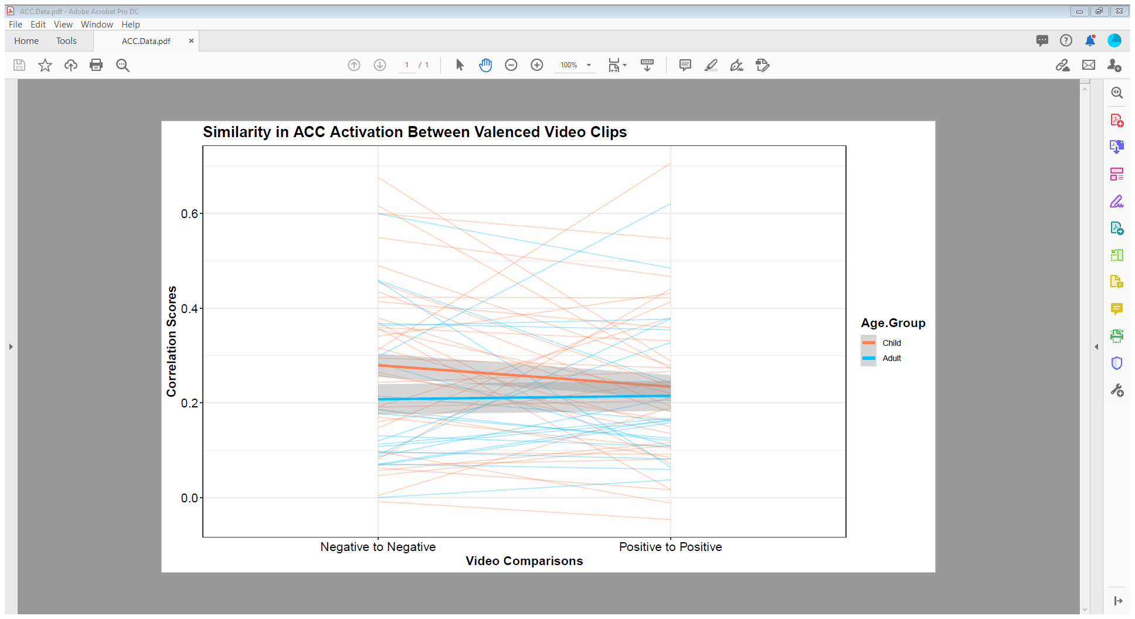
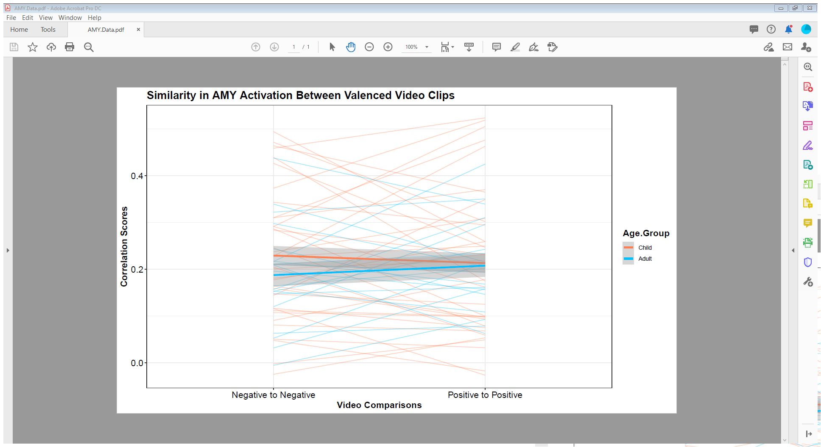
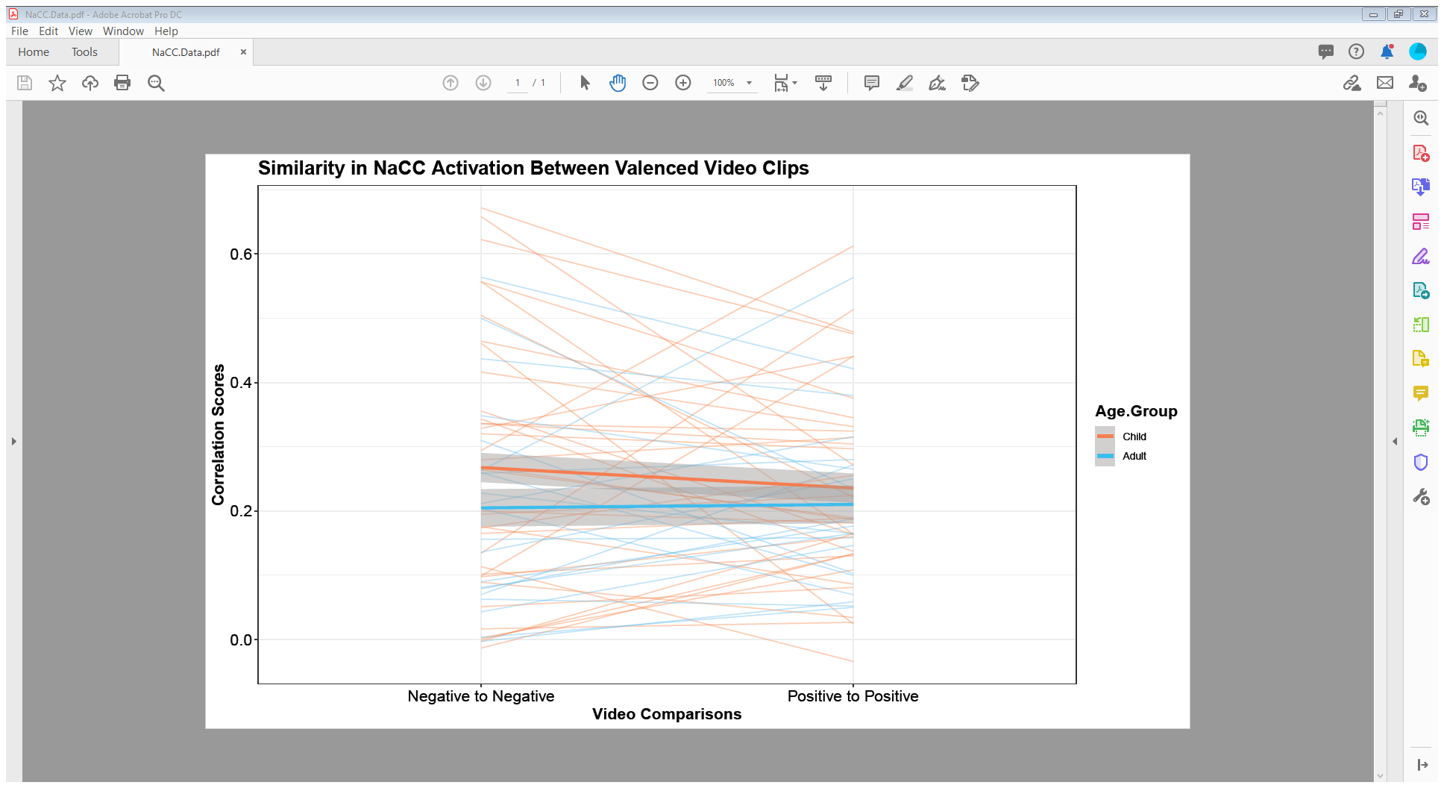
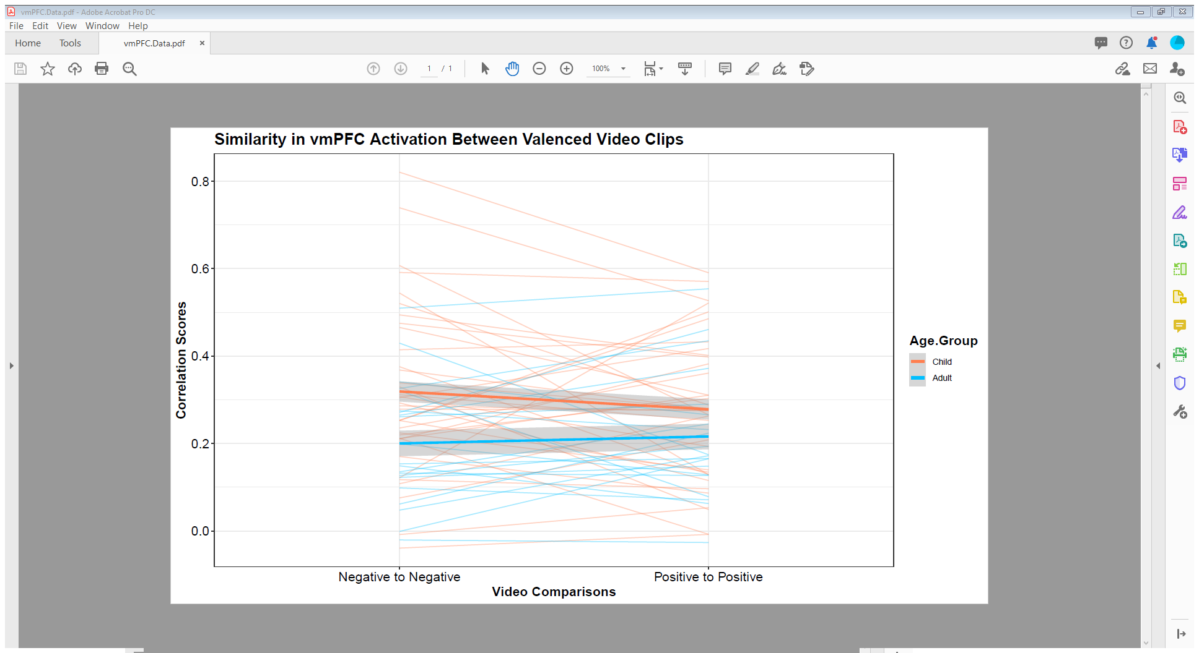

Slide 38
MLMs w/ Age and Valence Interactions
Interaction models within the ACC, AMY, and NaCC failed to outperform null models in fitting to the data. Age’s effect did increase within the vmPFC, but this model also failed to outperform null models.
ANTERIOR CINGULATE CORTEX
coef.est coef.se
(Intercept) 0.28 0.03
Age.Dummy -0.07 0.05
Val.PairPosPos -0.05 0.03
Age:Val.PairPosPos 0.05 0.05
Error terms:
Groups Name Std.Dev. Corr
Participant (Intercept) 0.16
Val.PairPosPos 0.14 -0.54
Residual 0.37
---
number of obs: 3192, groups: Participant, 57
AIC = 2832.9, DIC = 2817
deviance = 2816.9
AMYGDALA
coef.est coef.se
(Intercept) 0.23 0.02
Age.Dummy -0.04 0.03
Val.PairPosPos -0.02 0.02
Age:Val.PairPosPos 0.04 0.03
Error terms:
Groups Name Std.Dev. Corr
Participant (Intercept) 0.11
Val.PairPosPos 0.09 -0.27
Residual 0.30
---
number of obs: 3192, groups: Participant, 57
AIC = 1451.7, DIC = 1436
deviance = 1435.7
NUCLEUS ACCUMBENS
coef.est coef.se
(Intercept) 0.27 0.03
Age.Dummy -0.06 0.05
Val.PairPosPos -0.03 0.03
Age:Val.PairPosPos 0.04 0.05
Error terms:
Groups Name Std.Dev. Corr
Participant (Intercept) 0.17
Val.PairPosPos 0.14 -0.68
Residual 0.33
---
number of obs: 3192, groups: Participant, 57
AIC = 2209.4, DIC = 2193
deviance = 2193.4
VENTROMEDIAL PREFRONTAL CORTEX
coef.est coef.se
(Intercept) 0.32 0.03
Age.Dummy -0.12 0.05 *
Val.PairPosPos -0.04 0.03
Age:Val.PairPosPos 0.06 0.04
Error terms:
Groups Name Std.Dev. Corr
Participant (Intercept) 0.16
Val.PairPosPos 0.13 -0.54
Residual 0.34
---
number of obs: 3192, groups: Participant, 57
AIC = 2314.2, DIC = 2298
deviance = 2298.2
---
Signif. codes: 0 ‘***’ 0.001 ‘**’ 0.01 ‘*’ 0.05 ‘.’ 0.1 ‘ ’ 1
Notes:
Once again, when we moved on to interactions, the ACC, AMY, and NaCC disappointed us by failing to outperform the null models. The vmPFC on the other hand, showed some promise and out performed earlier models in an ANOVA

Slide 39
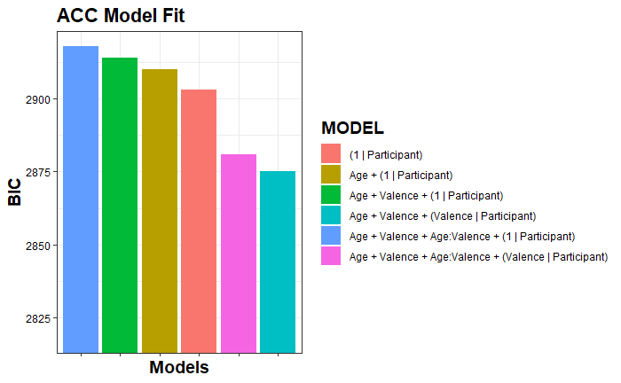
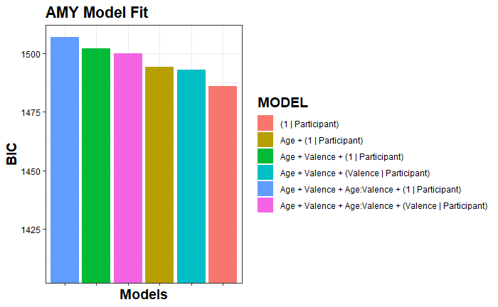
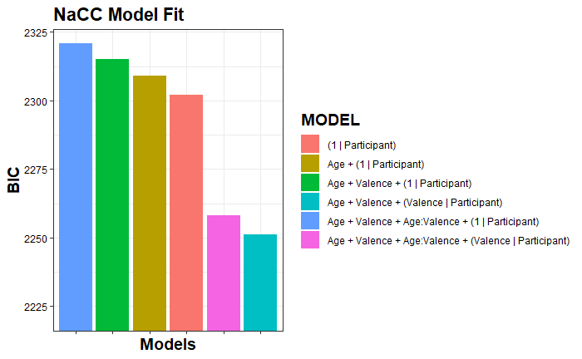
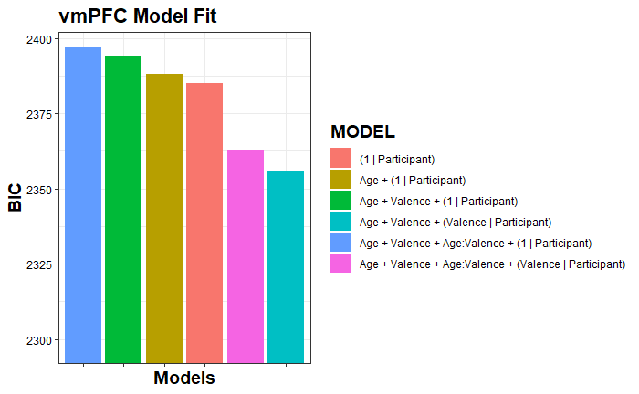
Notes:
Here I charted all of the BIC outputs to illustrate model fit. For those unfamiliar, R will give us two measurements of model fit, AIC and BIC. They prioritize different information. The idea for both of them is that the lower the result, the better the model fits the data. You can see our models in the legends. They are the same for all charts. You might also note a similar trend for all of them. Allowing valence to vary randomly notably improved our models in almost every case, except perhaps the amygdala. The AIC bears out roughly the same details. Ultimately, in each case, our best model does not include an age interaction, but allows valence to vary randomly.

Slide 40
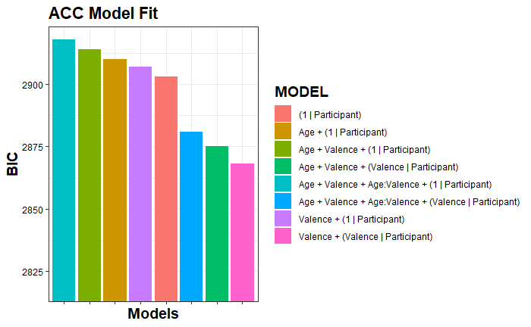
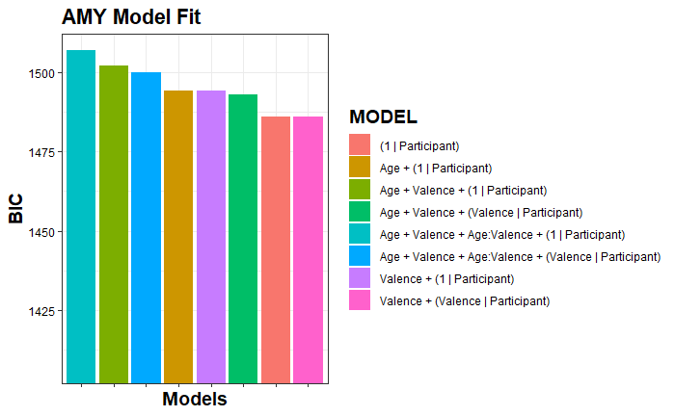
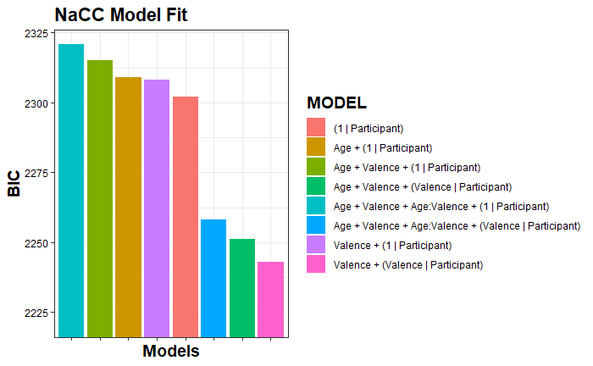
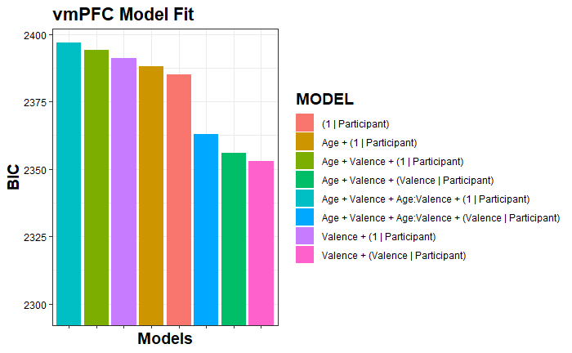
Notes:
Now, if we include models that don’t include age at all, they seem to be the best fitting models across the board.

Slide 41
What do we do with this information?

Slide 42
Steps in Building Models
Create null model (E.g., <- Correlation ~ 1 + (1 | Participant))
Calculate ICC of Null Model
ICCs > 0 justify the use of the MLM method
Add a fixed variable (E.g., <- Correlation ~ Age.Group + (1 | Participant))
If new model fits data better than null model by, add more fixed variables and compare to this model
If new model does not fit data better than null model, add more fixed variables and compare to null model.
Repeat Step 3 until all fixed variables have been exhausted
Add random slope(s)
If new model fits data better than previous best model, add additional slopes and compare to this model
Repeat Step 5 until all random slopes have been exhausted

Slide 43
Example of Model Building
NULL:
ACC.MLM0 <- lmer(Correlation ~ 1 + (1 | Participant))
Compared to NULL:
ACC.MLM1 <- lmer(Correlation ~ Valence.Pair + (1 | Participant))
Compared to NULL:
ACC.MLM2 <- lmer(Correlation ~ Age.Group + (1 | Participant))
Compared to Model 1:
ACC.MLM3 <- lmer(Correlation ~ Valence.Pair + Age.Group + (1 | Participant))
Compared to Model 3
ACC.MLM4 <- lmer(Correlation ~ Valence.Pair * Age.Group + (1 | Participant))
Compared to Model 4:
ACC.MLM5 <- lmer(Correlation ~ Valence.Pair * Age.Group + (Valence.Pair | Participant))

Slide 44
NOTE:
Because our visualizations did not seem to match our models, supplemental ANOVAs and contrasts were conducted with Bonferroni corrections. These were added to the results slides, also.
Age Group showed a significant main effect across ROIs, such that adults demonstrated lower r correlations values relative to their younger counterparts.
Valence Pairs were not significant in any case after Bonferroni adjustments.
There were no notable interaction effects.

Slide 45
Bivariate Fixed Effects Models
Age Group significantly predicted differences in neural activation similarity, such that, adults typically demonstrated lower correlation values than their younger counterparts.
Age Group Predicts Variance Differences in Activation
==========================================================================
Correlation (r value)
ACC AMY NaCC vmPFC
---------------------------------------------------------------------------------------------------
Age Group -0.042*** -0.019** -0.039*** -0.082***
(Adult) (0.010) (0.008) (0.009) (0.010)
Intercept 0.262*** 0.229*** 0.256*** 0.301***
(Child) (0.006) (0.005) (0.006) (0.006)
---------------------------------------------------------------------------------------------------
Observations 6,384 6,384 6,384 6,384
R2 0.003 0.001 0.003 0.011
Adjusted R2 0.002 0.001 0.003 0.011
Residual Std. Error (df = 6382) 0.394 0.316 0.361 0.367
F Statistic (df = 1; 6382) 16.90*** 5.51** 17.30*** 74.00***
=========================================================================
Note: *p<0.1; **p<0.05; ***p<0.01
Notes:
To start off, I wanted to establish that their was a relationship between age group and correlations. ||| Running a vanilla linear model, we see that across all ROIs, that seems to be true.

Slide 46
Multivariate Fixed Main Effects Models
Age Group maintains significance as valence is included in the model. Valence does not predict activation at this stage.
Age Group and Valence Predict Variance Differences in Activation
======================================================================
Correlation (r value)
ACC AMY NaCC vmPFC
----------------------------------------------------------------------
Adult -0.042*** -0.019** -0.039*** -0.082***
(0.010) (0.008) (0.009) (0.010)
Mixed Valence Comparisons -0.001 0.016* 0.003 0.001
(0.012) (0.010) (0.011) (0.011)
Positive Valence Comparisons -0.026* -0.003 -0.018 -0.020
(0.014) (0.011) (0.013) (0.013)
Intercept 0.269*** 0.221*** 0.259*** 0.305***
(0.011) (0.008) (0.010) (0.010)
----------------------------------------------------------------------
Observations 6,384 6,384 6,384 6,384
R2 0.003 0.002 0.003 0.012
Adjusted R2 0.003 0.001 0.003 0.012
Residual Std. Error (df = 6380) 0.394 0.316 0.361 0.367
F Statistic (df = 3; 6380) 7.260*** 3.560** 7.000*** 25.900***
======================================================================
Note: *p<0.1; **p<0.05; ***p<0.01
Notes:
We added Valence Pair as well, which in itself, did not alter the effects of age group much, and didn’t offer any additional explanatory power.

Slide 47
Multivariate Fixed Main Effects Models
Age Group and Valence Predict Variance Differences in Activation
=======================================================================================================================================================================================
Correlation (r value)
ACC ACC AMY AMY NaCC NaCC vmPFC vmPFC
---------------------------------------------------------------------------------------------------------------------------------------------------------------------------------------------------------------------
Adults -0.042*** -0.042*** -0.019** -0.019** -0.039*** -0.039*** -0.082*** -0.082***
(0.010) (0.010) (0.008) (0.008) (0.009) (0.009) (0.010) (0.010)
Mixed Valence Comparisons -0.001 0.016* 0.003 0.001
(0.012) (0.010) (0.011) (0.011)
Positive Valence Comparisons -0.026* -0.003 -0.018 -0.020
(0.014) (0.011) (0.013) (0.013)
Child Negative Valence Comparisons 0.262*** 0.269*** 0.229*** 0.221*** 0.256*** 0.259*** 0.301*** 0.305***
(INTERCEPT) (0.006) (0.011) (0.005) (0.008) (0.006) (0.010) (0.006) (0.010)
-------------------------------------------------------------------------------------------------------------------------------------------------------------------------------------------------------------------
Observations 6,384 6,384 6,384 6,384 6,384 6,384 6,384 6,384
R2 0.003 0.003 0.001 0.002 0.003 0.003 0.011 0.012
Adjusted R2 0.002 0.003 0.001 0.001 0.003 0.003 0.011 0.012
Residual Std. Error 0.394 (df = 6382) 0.394 (df = 6380) 0.316 (df = 6382) 0.316 (df = 6380) 0.361 (df = 6382) 0.361 (df = 6380) 0.367 (df = 6382) 0.367 (df = 6380)
F Statistic 16.9*** (df = 1; 6382) 7.26*** (df = 3; 6380) 5.5** (df = 1; 6382) 3.6** (df = 3; 6380) 17.3*** (df = 1; 6382) 7.0*** (df = 3; 6380) 74.0*** (df = 1; 6382) 25.9*** (df = 3; 6380)
=========================================================================================================================================================================================
Note: *p<0.1; **p<0.05; ***p<0.01

Slide 48
Fixed Interaction Effect Models
Age Group maintains significance as interactions are added to the model. ROI specific valence main effects and interactions emerge.
Age Group and Valence Predict Variance Differences in Activation
=====================================================================================
Correlation (r value)
ACC AMY NaCC vmPFC
---------------------------------------------------------------------------
Adult -0.072*** -0.042** -0.063*** -0.119***
(0.020) (0.016) (0.019) (0.019)
Mixed Valence Comparisons -0.013 0.007 -0.008 -0.016
(0.015) (0.012) (0.014) (0.014)
Positive Valence Comparisons -0.045** -0.016 -0.032** -0.041**
(0.018) (0.014) (0.016) (0.016)
Adult / Mixed Interaction 0.033 0.027 0.029 0.045*
(0.025) (0.020) (0.023) (0.023)
Adult / Positive Interaction 0.052* 0.036 0.037 0.057**
(0.029) (0.023) (0.027) (0.027)
Intercept 0.280*** 0.229*** 0.268*** 0.319***
(0.012) (0.010) (0.011) (0.012)
---------------------------------------------------------------------------
Observations 6,384 6,384 6,384 6,384
R2 0.004 0.002 0.004 0.013
Adjusted R2 0.003 0.001 0.003 0.012
Residual Std. Error (df = 6378) 0.394 0.316 0.361 0.367
F Statistic (df = 5; 6378) 5.040*** 2.680** 4.660*** 16.600***
=====================================================================================
Note: *p<0.1; **p<0.05; ***p<0.01
Notes:
When we move on to interactions, though, we see effects of age group increase a lot. Furthermore, we see notable differences in the ACC, NaCC, and vmPFC between Positive and Negative correlations.

Slide 49
Fixed Interaction Effect Models
Age Group maintains significance as interactions are added to the model. ROI specific valence main effects and interactions emerge.
Age Group and Valence Predict Variance Differences in Activation
=====================================================================================
Correlation (r value)
ACC AMY NaCC vmPFC
---------------------------------------------------------------------------
Adult -0.072*** -0.042** -0.063*** -0.119***
(0.020) (0.016) (0.019) (0.019)
Mixed Valence Comparisons -0.013 0.007 -0.008 -0.016
(0.015) (0.012) (0.014) (0.014)
Positive Valence Comparisons -0.045** -0.016 -0.032** -0.041**
(0.018) (0.014) (0.016) (0.016)
Adult / Mixed Interaction 0.033 0.027 0.029 0.045*
(0.025) (0.020) (0.023) (0.023)
Adult / Positive Interaction 0.052* 0.036 0.037 0.057**
(0.029) (0.023) (0.027) (0.027)
Intercept 0.280*** 0.229*** 0.268*** 0.319***
(0.012) (0.010) (0.011) (0.012)
---------------------------------------------------------------------------
Observations 6,384 6,384 6,384 6,384
R2 0.004 0.002 0.004 0.013
Adjusted R2 0.003 0.001 0.003 0.012
Residual Std. Error (df = 6378) 0.394 0.316 0.361 0.367
F Statistic (df = 5; 6378) 5.040*** 2.680** 4.660*** 16.600***
=====================================================================================
Note: *p<0.1; **p<0.05; ***p<0.01
Notes:
Additionally, these models are improvements over the two previous models, judging by adj R squared values. Granted, these models are still very weak overall.

Slide 50
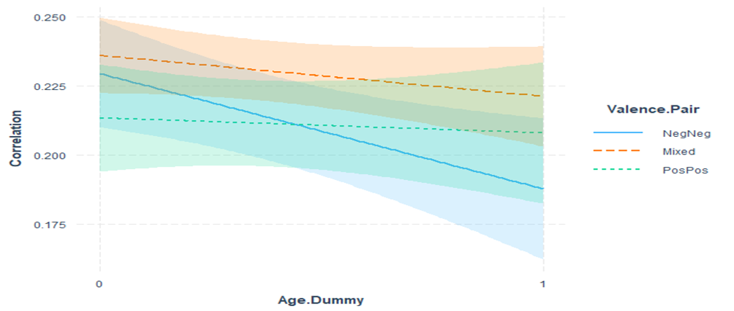
AMY
Notes:
Here we can see the interactions between the valences by ROI. 0 represents child and 1 represents adult as a reminder. We see pretty much across the board NegNeg showing what appears to be a notably different slope than the other valences, which is notable when we move on to MLMs. The Amygdala appears to be the odd one out of the bunch, though, as it seems that Mixed valence stimuli correlations do not interact and are generally more similar than congruent valence pairs.

Slide 51
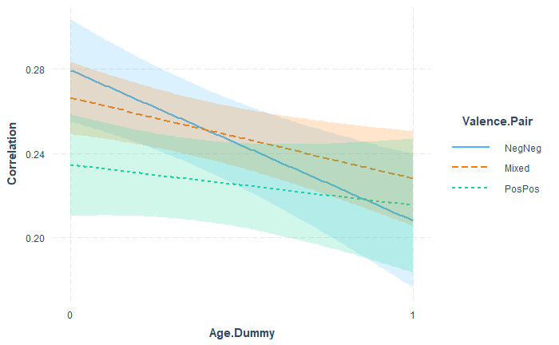
ACC
Notes:
The graphs for ACC, NaCC, and vmPFC looks pretty similar with NegNeg showing the gravest changes by age group.

Slide 52
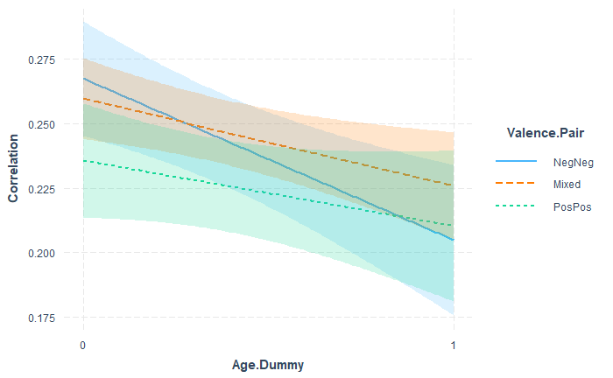
NaCC

Slide 53
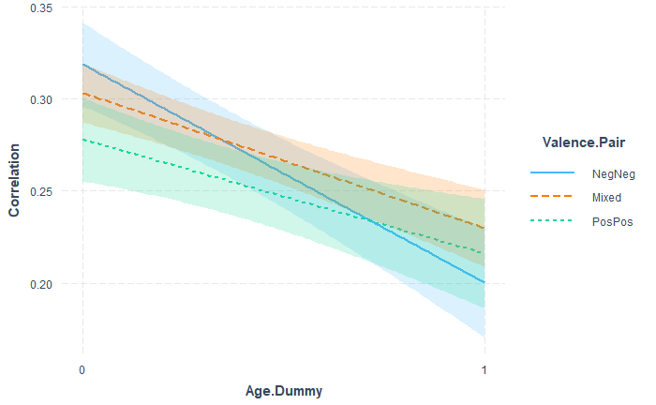
vmPFC
Notes:
Here for the vmPFC, you can see a similar pattern, although, if you pay attention to the confidence intervals, ||| you can se the significant interaction between Pos and Neg comparisons.
At this stage, given our adult population is more accurately described as “young adult”, I wonder if this is a reflection of the pre-positivity bias stages. My assumption is that when something looms larger in your awareness, there exists greater variability in how you analyze it. If young adults are prone to place greater focus on the negative than the positive, it might explain this flip. That in conjunction with a lack of sophistication or nuance in how children think of emotion might explain the flip.

Slide 54
Fixed Interaction Effect Models
Age Group maintains significance as interactions are added to the model. ROI specific valence main effects and interactions emerge.
Age Group and Valence Predict Variance Differences in Activation
=====================================================================================
Correlation (r value)
ACC AMY NaCC vmPFC
---------------------------------------------------------------------------
Adult -0.072*** -0.042** -0.063*** -0.119***
(0.020) (0.016) (0.019) (0.019)
Mixed Valence Comparisons -0.013 0.007 -0.008 -0.016
(0.015) (0.012) (0.014) (0.014)
Positive Valence Comparisons -0.045** -0.016 -0.032** -0.041**
(0.018) (0.014) (0.016) (0.016)
Adult / Mixed Interaction 0.033 0.027 0.029 0.045*
(0.025) (0.020) (0.023) (0.023)
Adult / Positive Interaction 0.052* 0.036 0.037 0.057**
(0.029) (0.023) (0.027) (0.027)
Intercept 0.280*** 0.229*** 0.268*** 0.319***
(0.012) (0.010) (0.011) (0.012)
---------------------------------------------------------------------------
Observations 6,384 6,384 6,384 6,384
R2 0.004 0.002 0.004 0.013
Adjusted R2 0.003 0.001 0.003 0.012
Residual Std. Error (df = 6378) 0.394 0.316 0.361 0.367
F Statistic (df = 5; 6378) 5.040*** 2.680** 4.660*** 16.600***
=====================================================================================
Note: *p<0.1; **p<0.05; ***p<0.01
Notes:
Unfortunately, the ACC, AMY, and NaCC fail to show significant interactions, making a moderation test a bad move in those cases. When I tested moderation for the vmPFC using a simple slopes analysis, thought:

Slide 55
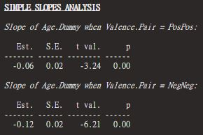
Valence as Moderator
A simple slopes analysis suggests that valence pair acts as a moderating factor for age group and activation similarity within the vmPFC
Notes:
The results further supported the idea that valence moderates the relationship between age group and valence similarity.

Slide 56
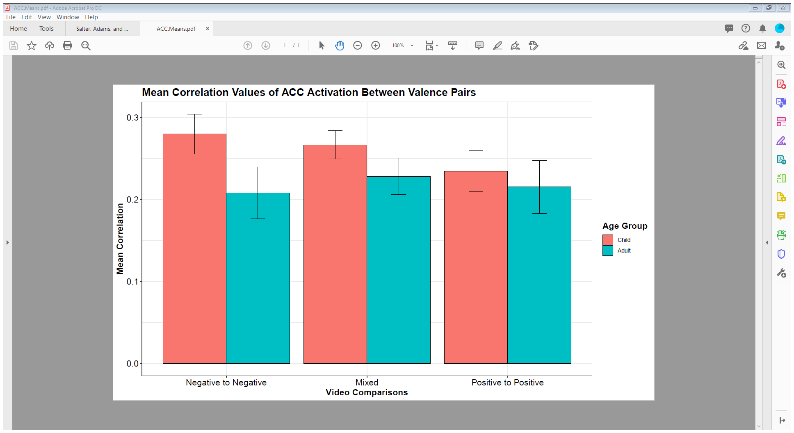
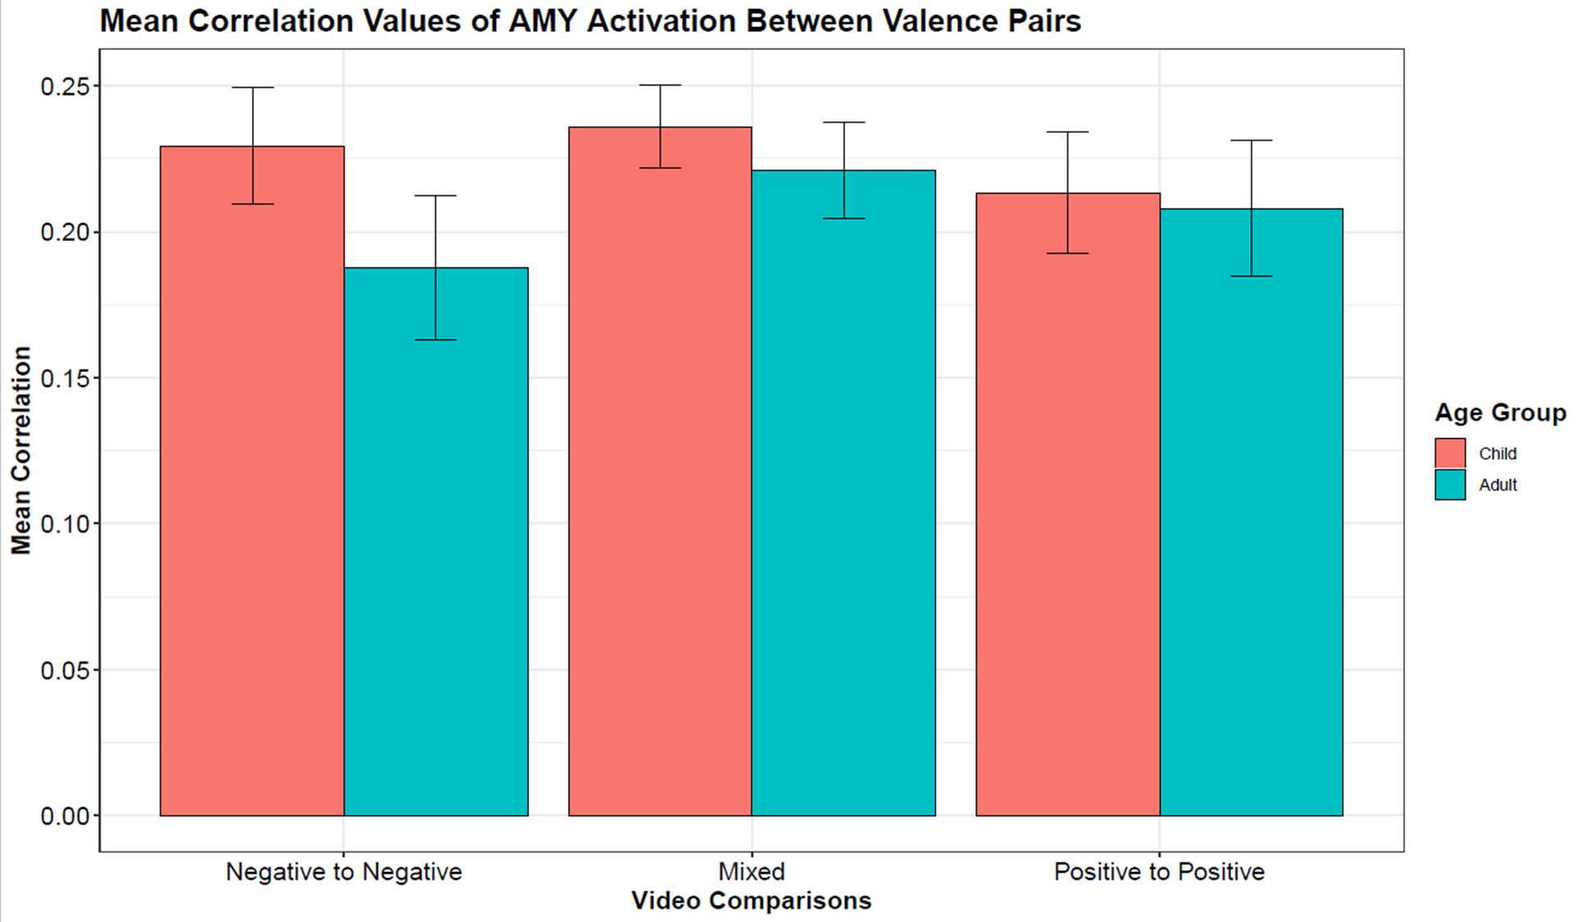
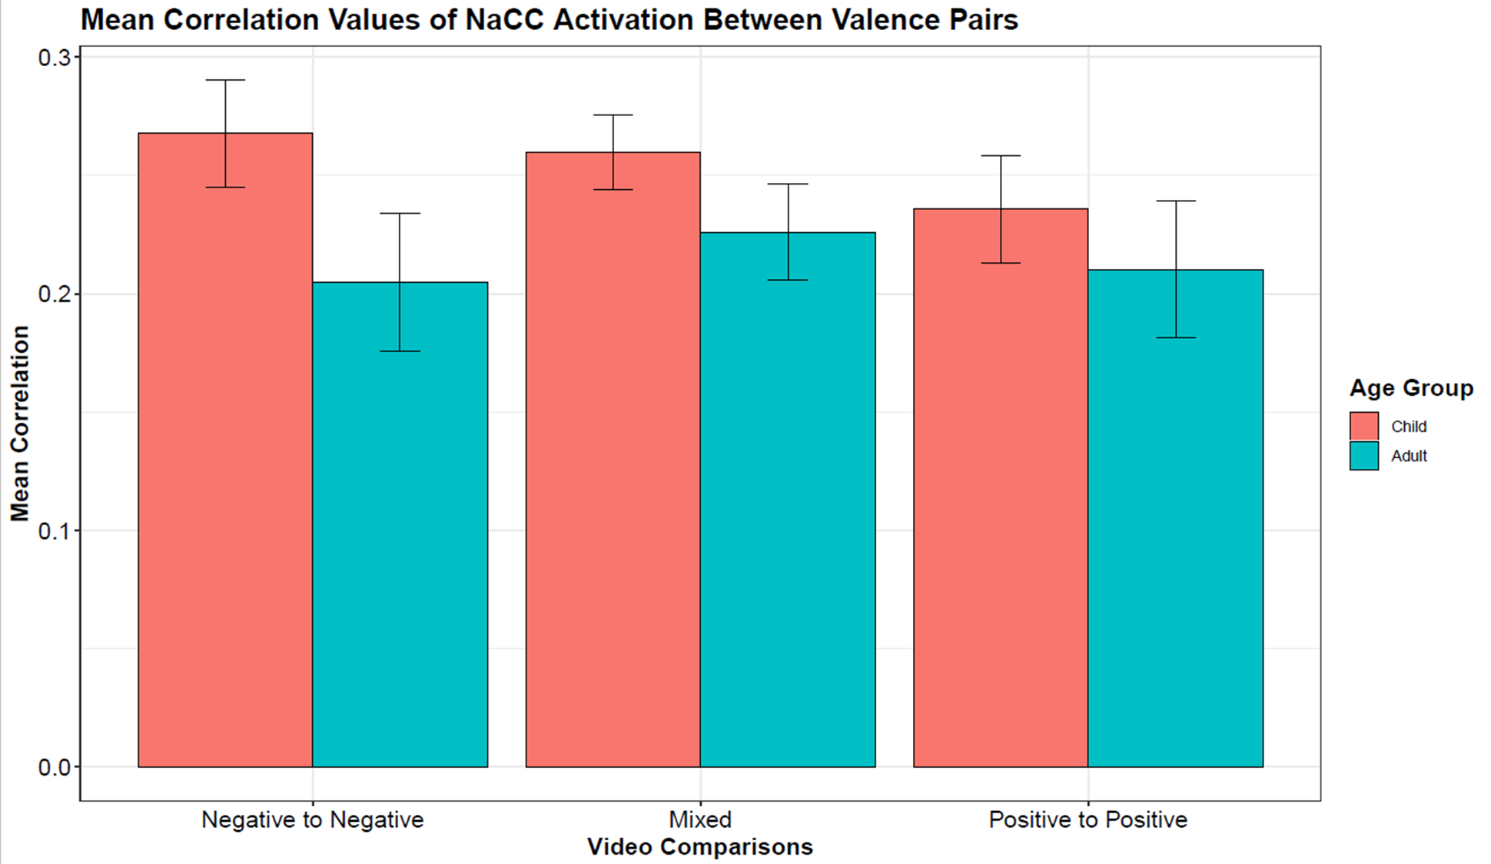
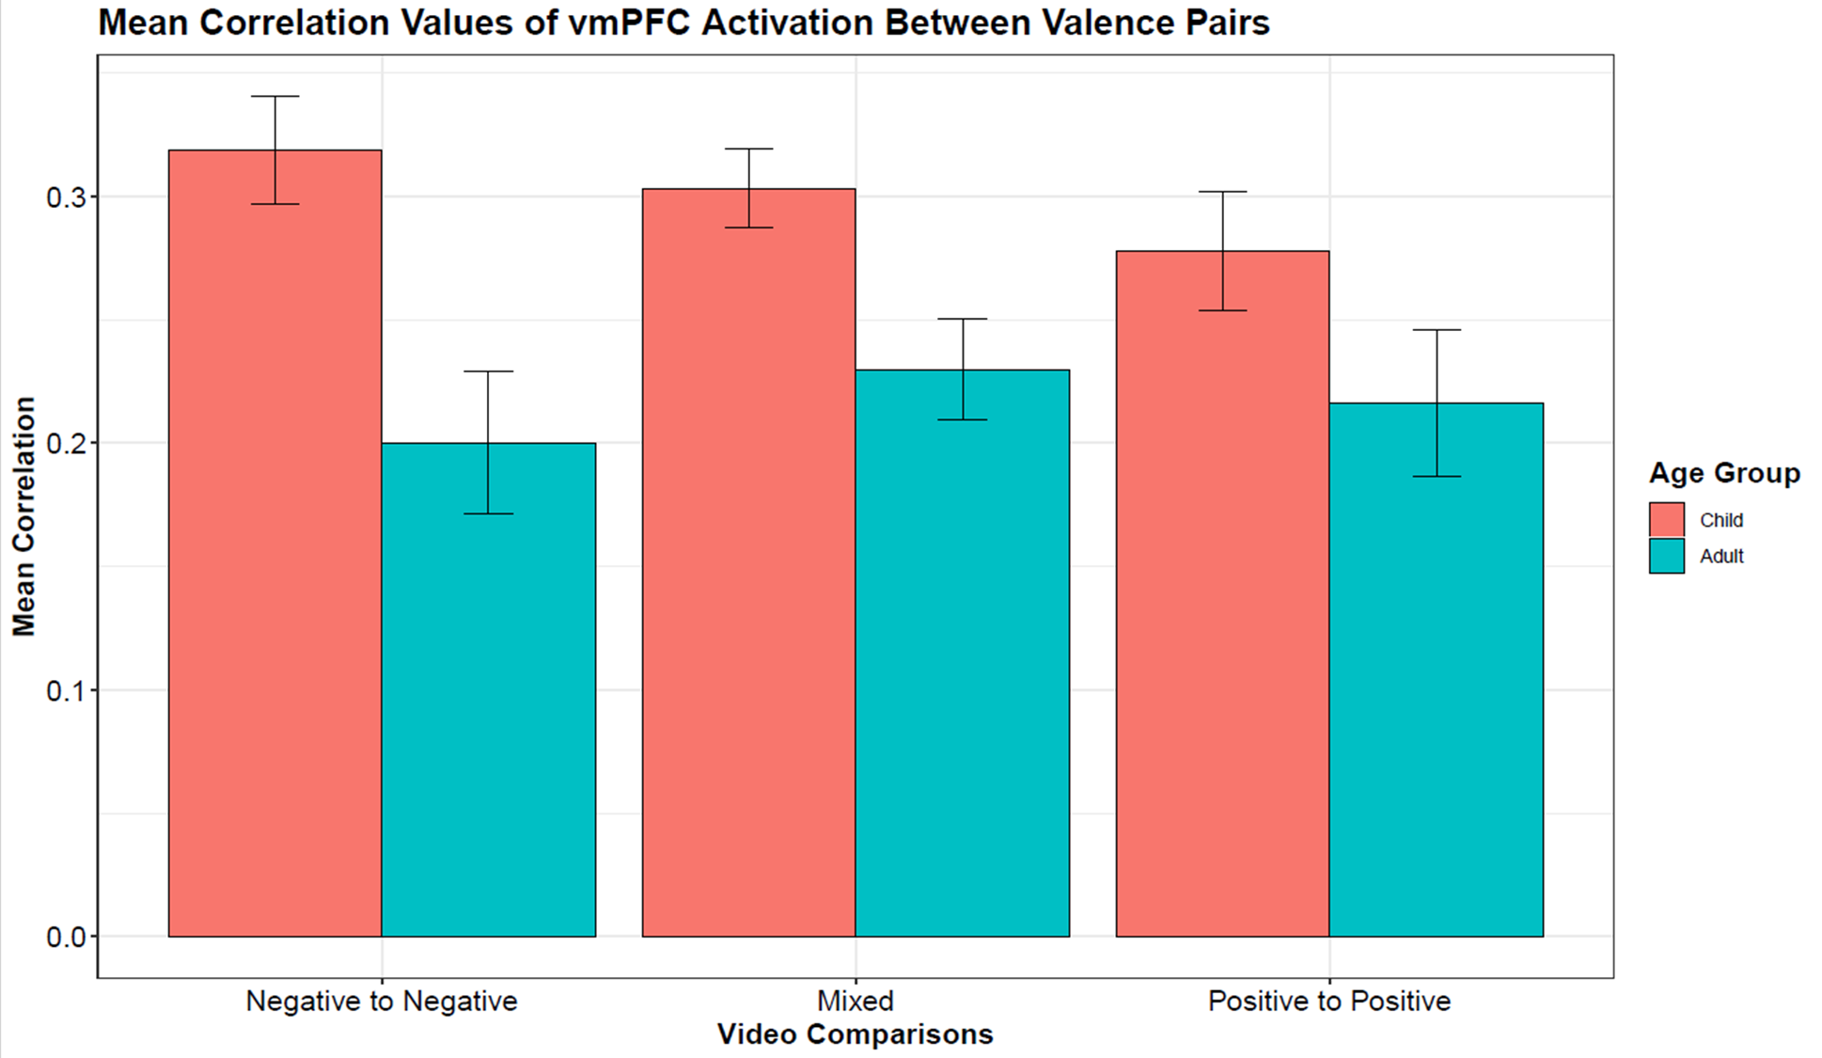
Notes:
These are just some nice little bar graphs illustrating the effects of age and valence . Again you can see in the ACC, AMY and NaCC some pretty mixed results, while the vmPFC shows a much cleaner story.

Slide 57
MLMs w/ Age and Valence Interactions
vmPFC shows age to increase in estimated effect after controlling for individual differences. Additionally, there are significant interactions between valence and age. This model performs better than the null model.
VENTROMEDIAL PREFRONTAL CORTEX
coef.est coef.se
(Intercept) 0.32 0.03
Age.Dummy -0.12 0.05 *
Val.PairPosPos -0.04 0.03
Age:Val.PairPosPos 0.06 0.04
Error terms:
Groups Name Std.Dev. Corr
Participant (Intercept) 0.16
Val.PairPosPos 0.13 -0.54
Residual 0.34
---
number of obs: 3192, groups: Participant, 57
AIC = 2314.2, DIC = 2298
deviance = 2298.2
---
Signif. codes: 0 ‘***’ 0.001 ‘**’ 0.01 ‘*’ 0.05 ‘.’ 0.1 ‘ ’ 1
Notes:
Once again, when we moved on to interactions, the ACC, AMY, and NaCC disappointed us by failing to outperform the null models. The vmPFC on the other hand, showed some promise and out performed earlier models in an ANOVA

Slide 58
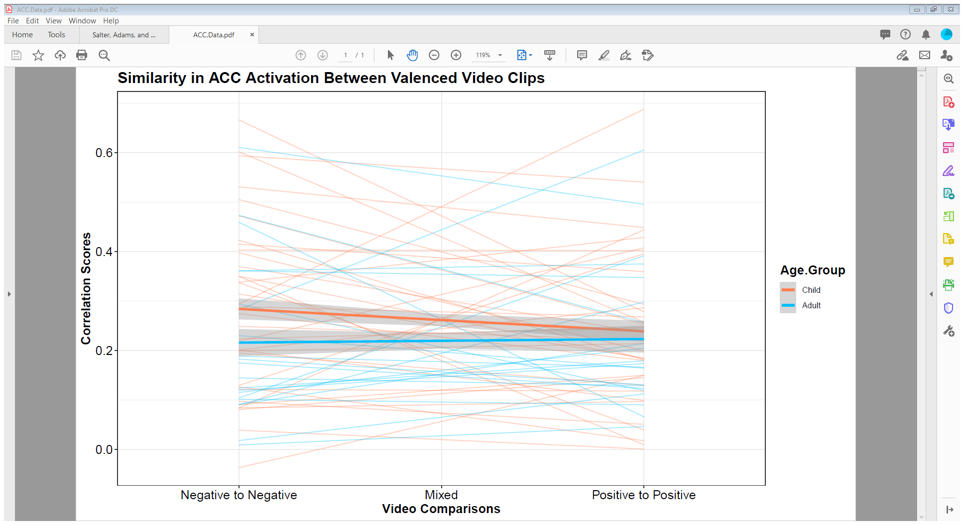
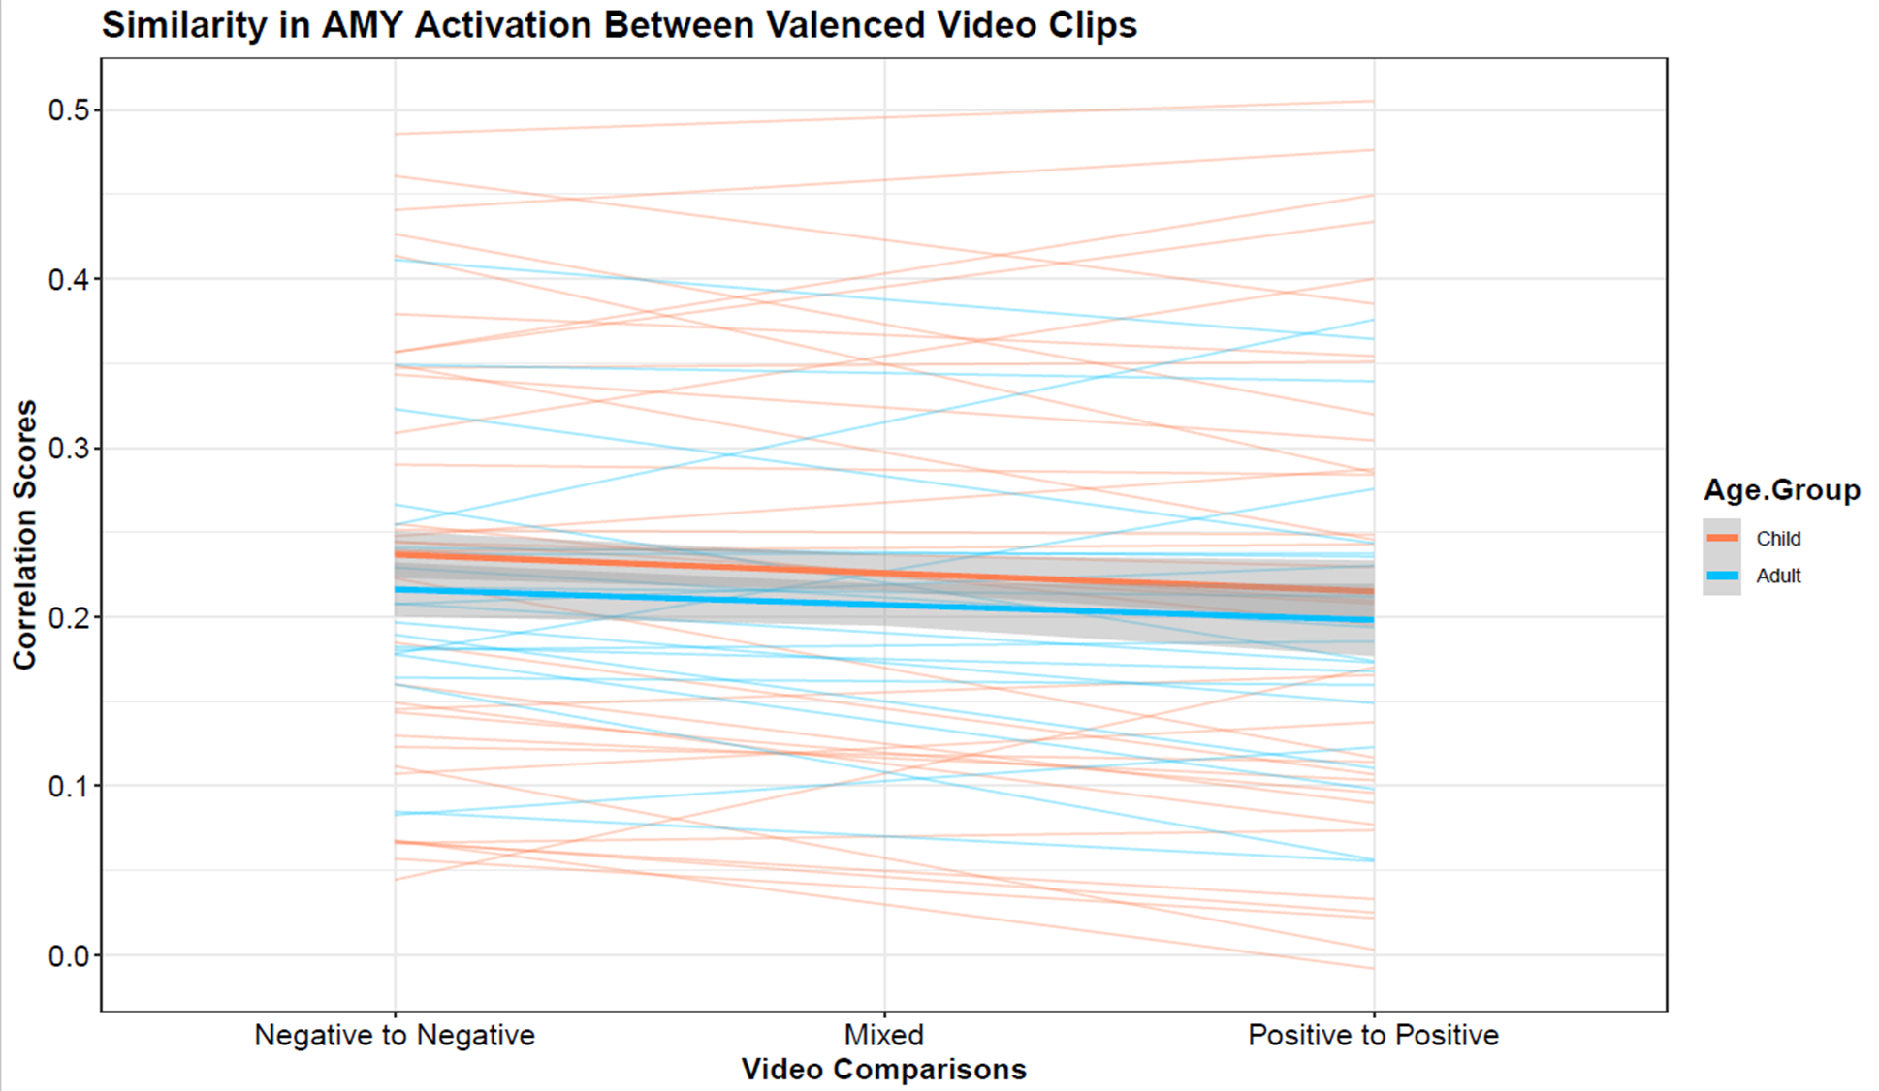
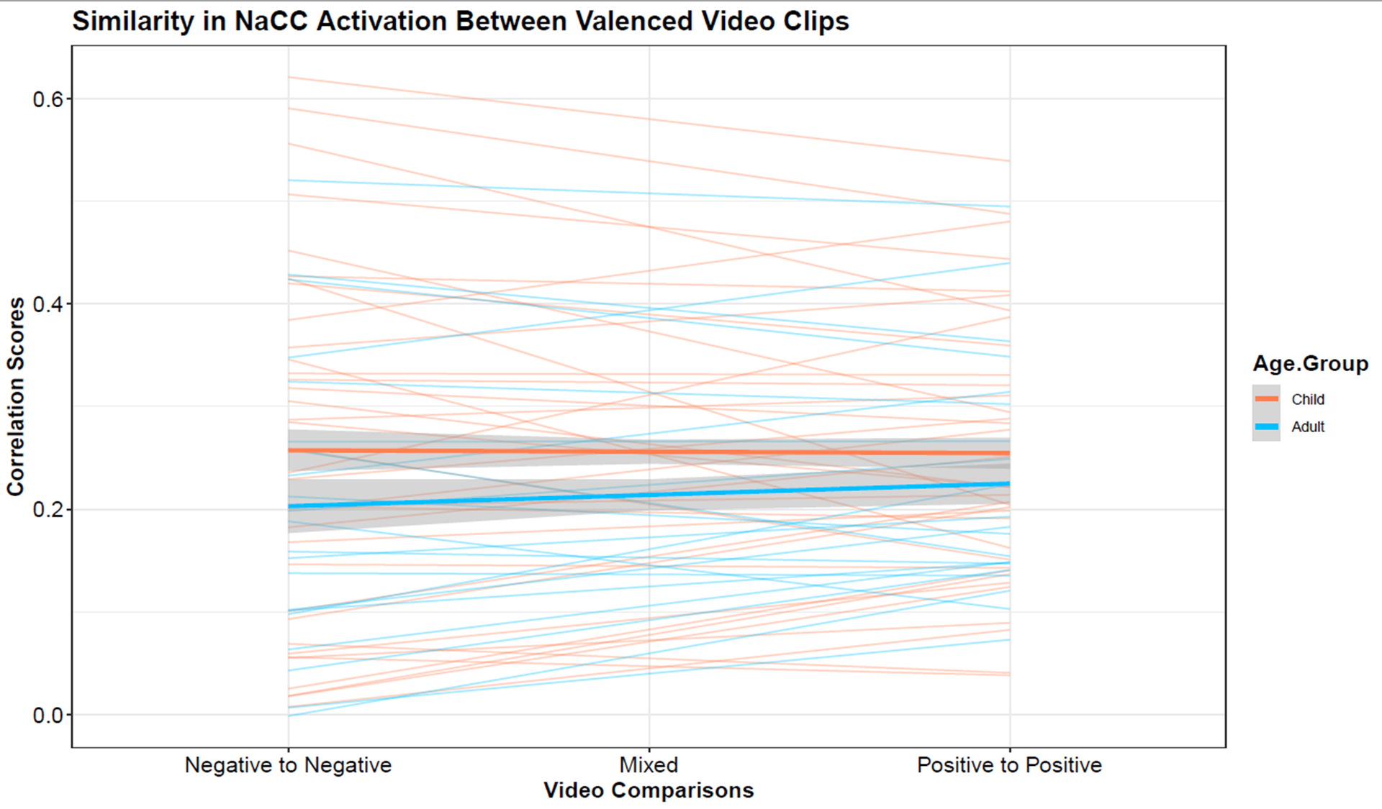
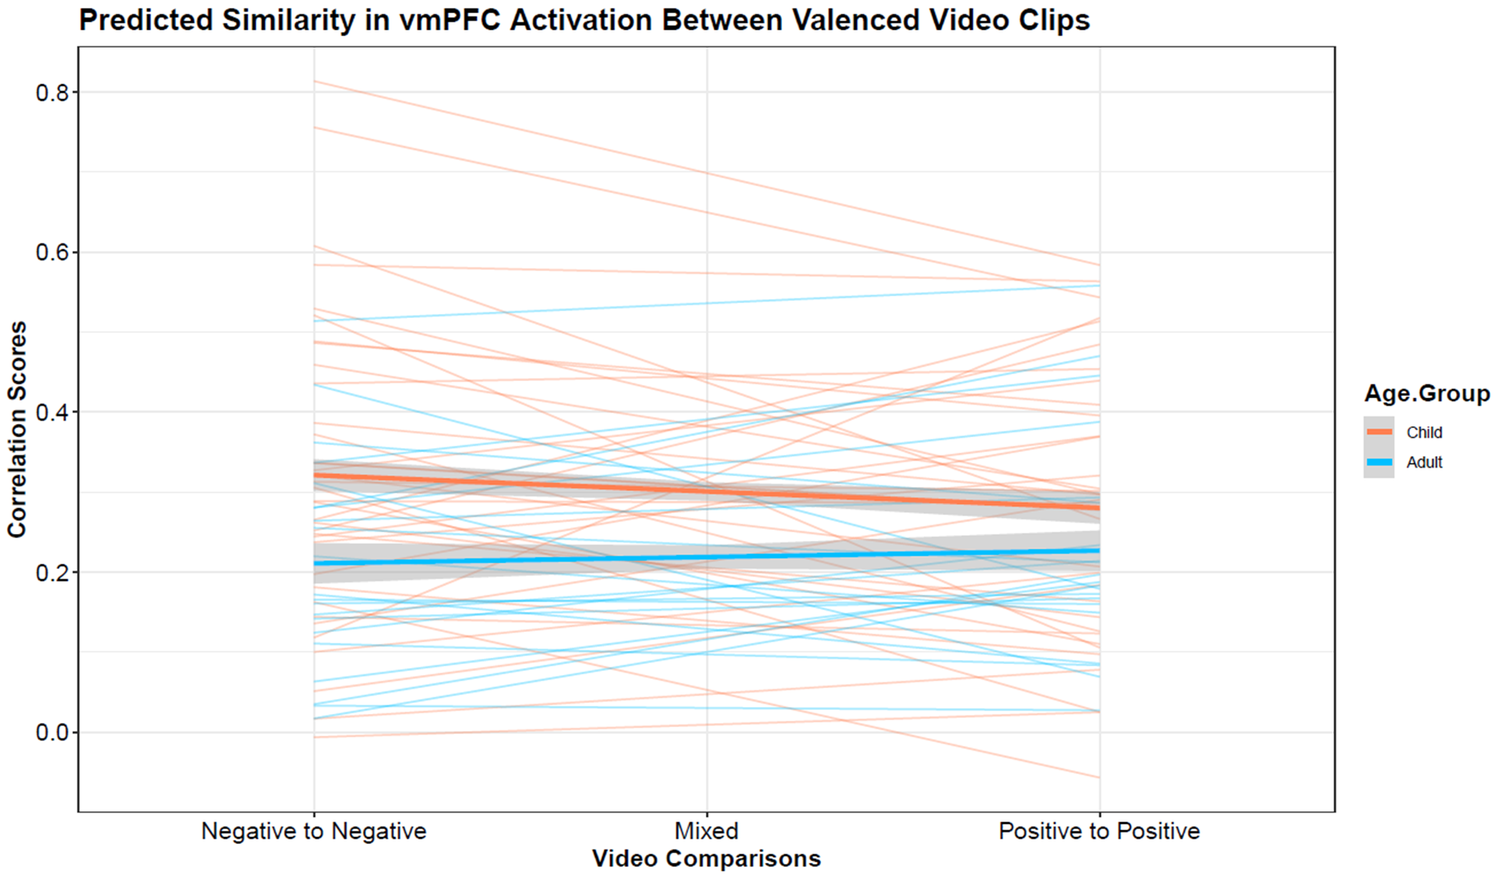

Slide 59
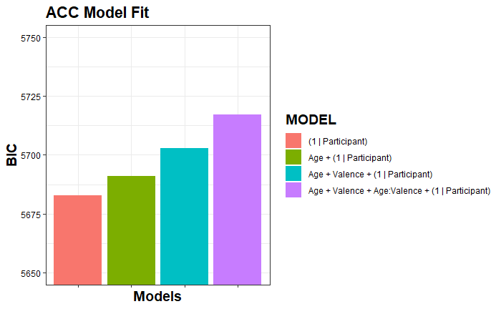

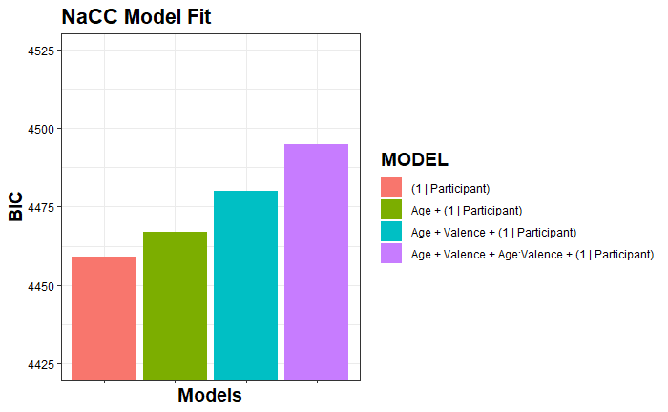
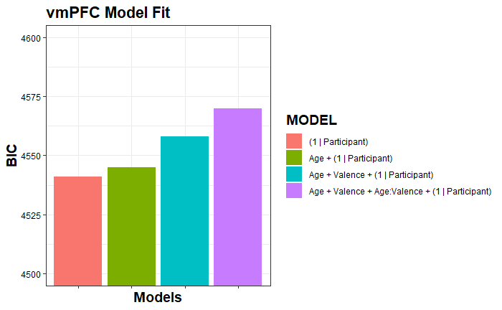
Notes:
Here I charted all of the BIC outputs to illustrate model fit. For those unfamiliar, R will give us two measurements of model fit, AIC and BIC. They prioritize different information. The idea for both of them is that the lower the result, the better the model fits the data. You can see the same trend for all of them. ||| The eagle eyed among you might be getting ready to yell at me, “ but the vmPFC’s Null model has a lower BIC than our ideal model, what gives?”, which is correct…

Slide 60
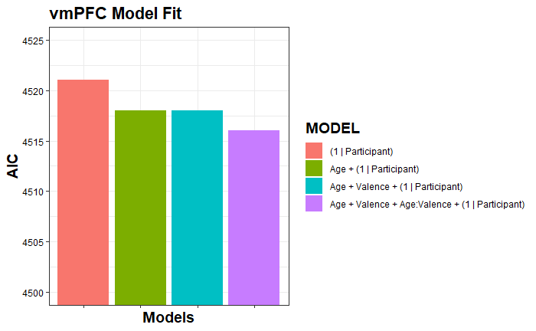
Notes:
And it appears its significance is due entirely to a disagreement between the AIC and BIC. This is the output from the AIC. So, although R’s anova tells me this is a better model than the null, I’m inclined to defer to the BIC, as I’m told is good practice.

Slide 61
HOWEVER!!!!

Slide 62
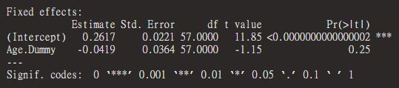
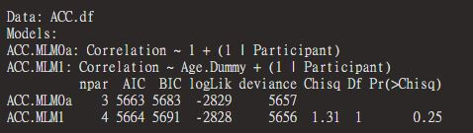
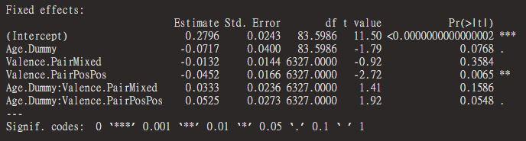
ACC

Slide 63

MLMs Allowing Random Slopes
In all cases, adding valence pair as a random slope within participant resulted in singularity issues, suggesting model overfitting.
Model Example:
Notes:
When I moved on to adding valence as a random slope, we ran into an issue. Across the board, models either failed to converge or we ran into a singularity issue, where the random effect of Negative comparisons correlated with Positive comparisons at a rate of nearly 1 to 1. ||| I guess that means its kind of good news that there wasn’t a ton of variability across participants in how they were implicitly categorizing these stimuli. On the screen is just an example from the ACC, where I circled the correlations we got back.

Slide 64


ACC
Power Analysis of Full Model: 46%
Neither Age Groups nor Valence Categories were significant once Valence Pair slopes were allowed to vary randomly.
Correlation ~ Age Group * Valence Pair + (1 | Participant)
Correlation ~ Age Group * Valence Pair + (Valence Pair | Participant) [Best fitted model]

Slide 65



Slide 66

AMY
Power Analysis of Full Model: 42%
Neither Age Groups nor Valence Categories were significant once Valence Pair slopes were allowed to vary randomly.
Correlation ~ Age Group * Valence Pair + (Valence Pair | Participant) [Best fitted model]
Despite the model above registering stronger than the null model, all models between this model and null model were not significant improvements, making me wonder if this is an example of overfitting?

Slide 67
MLMs Adj. for Individual Differences
For ACC, AMY, and NaCC, Age Group’s influence was diminished once individual differences were included as a random effect in the model.
vmPFC maintained Age Group differences after allowing intercepts to vary randomly by participant.
ANTERIOR CINGULATE CORTEX
coef.est coef.se
(Intercept) 0.26 0.02
Age.Dummy -0.04 0.04
Error terms:
Groups Name Std.Dev.
Participant (Intercept) 0.13
Residual 0.37
---
number of obs: 6384, groups: Participant, 57
AIC = 5663.8, DIC = 5656
deviance = 5655.8
AMYGDALA
coef.est coef.se
(Intercept) 0.23 0.02
Age.Dummy -0.02 0.03
Error terms:
Groups Name Std.Dev.
Participant (Intercept) 0.11
Residual 0.30
---
number of obs: 6384, groups: Participant, 57
AIC = 2739.1, DIC = 2731
deviance = 2731.1
NUCLEUS ACCUMBENS
coef.est coef.se
(Intercept) 0.26 0.02
Age.Dummy -0.04 0.04
Error terms:
Groups Name Std.Dev.
Participant (Intercept) 0.13
Residual 0.34
---
number of obs: 6384, groups: Participant, 57
AIC = 4440, DIC = 4432
deviance = 4432.0
VENTROMEDIAL PREFRONTAL CORTEX
coef.est coef.se
(Intercept) 0.30 0.02
Age.Dummy -0.08 0.04
Error terms:
Groups Name Std.Dev.
Participant (Intercept) 0.14
Residual 0.34
---
number of obs: 6384, groups: Participant, 57
AIC = 4518.4, DIC = 4510
deviance = 4510.4
Notes:
The moment I added individual differences to the models, though, the ACC, AMY and NaCC packed their bags and went home. It pretty much sucked up all the variance we previously saw. ||| If we eyeball the estimates and standard errors for the top three models, we can see how close the estimates for adults and kids are. As a reminder kids are our reference group. That being said, the vmPFC made it through the first trial by the skin of its teeth with a 0.04 significance rating. We can also see that the average r value for kids was a .3 while adults dropped down to a .22.

Slide 68

NaCC
Might be overfitted
Power Analysis of Full Model: 02%
Neither Valence Categories were significant once Valence Pair slopes were allowed to vary randomly.
Correlation ~ Valence Pair + (Valence Pair | Participant) [Best fitted model]
Age Group did not fit well within our model
Despite the model above registering stronger than the null model, all models between this model and null model were not significant improvements, making me wonder if this is an example of overfitting?

Slide 69



Slide 70


vmPFC
Power Analysis of Full Model: 58%
Valence Categories were significant once Valence Pair slopes were allowed to vary randomly. However, Age Group was.
Correlation ~ Age Group * Valence Pair + (1 | Participant)
Correlation ~ Age Group * Valence Pair + (Valence Pair | Participant) [Best fitted model]

Slide 71






Slide 72
Data Issues
Uneven sample sizes in Age Group (Children to Adults)
Uneven sample sizes in Valence Pair (Mixed to Congruent Pairs)
Kurtosis in Activation Data
Negative Skew in Correlation Data
MLMs may have been significantly underpowered to measure effects
(1000 Simulations ran)
POWER | Age Group | Valence | Interaction
ACC | 36.80 % | 73.70 % | 40.20 %
CIs | (33.80 % – 39.87 %) | (70.85 % – 76.41 %) | (37.14 % – 43.31 %)
AMY | 38.20 % | 38.80 % | 34.40 %
CIs | (35.18 % – 41.29 %) | (35.77 % – 41.90 %) | (31.46 % – 37.44 %)
NaCC | 36.40 % | 49.90 % | 27.60 %
CIs | (33.41 % – 39.47 %) | (46.26 % – 52.55 %) | (24.85 % – 30.48 %)
vmPFC | 38.00 % | 70.50 % | 59.70 %
CIs | (34.98 % – 41.09 %) | (67.57 % – 73.31 %) | (56.59 % – 62.76 %)
Notes:
On top of that issue, we do have the minor issues of sample sizes, the kurtosis and negative skew, and, what I hadn’t mentioned earlier: power. I ran a post-hoc power analysis and found that, assuming our effect sizes are true, we may be underpowered to measure them. Even in the best case scenario, the vmPFC, we’re a little shy of the typical 80% to measure both age effects and valence effects.

Slide 73
Explanations of Results
Lack of power?
Age Groups better explained by individual differences?

